Slide 1
Dashboard Interactive Marketing
Minnesota Association Of CVBs Presentation

Slide 2
DASHBOARD INTERACTIVE MARKETING
Digital marketing firm that emphasizes measurable results
Founded in January of 2006
12 team members
Work with small- and medium-sized businesses, agencies, and nonprofits
Google Certified Partner
Focus: digital marketing, website development, conversion optimization

Slide 3
WHAT WE DO…
We provide SMB’s, agencies and nonprofits with digital marketing, website development and social media marketing expertise to help generate trackable, measurable outcomes (leads, forms completions, etc.)
Leverage deep dive Analytics to Measure the Return on Investment and the effectiveness of our digital marketing initiatives for fact-based decision making.
Generate conversions from existing digital marketing budgets
(More for less or for the same budget)

Slide 4
SERVICES WE PROVIDE
Digital Marketing Strategy Development and Implementation
Mobile First Website Development and Design
Web Analytics Strategy Development and Implementation
Audits (SEO, Paid Search, Conversion Optimization, Social Media, Content, etc..)
Competitive Analysis
Search Engine Optimization (SEO)
Pay-Per-Click Advertising (PPC)
Social Media Marketing
eNewsletter Marketing
Content Strategy
Amazon Strategy Development and Implementation
Content Creation
Blog Marketing
Banner Advertising
Reputation Management
Local Search Marketing
Call Tracking
Lead Nurturing
Link Building
Online Public Relations

Slide 5
THE FOUNDATION
The Digital Marketing Strategy
The Roadmap that that leads to success:
Assess current tactics or strategy
Identify target audience
Personas - characteristics
Where do you find them?
What vehicles can you use to reach them?
Where do they get their information
Messaging, what do we say to them?
Marketing Calendar
Ensure all Google tools are set up properly
Analytics - how do we measure success?
Execute
Your Digital Marketing Strategy is a working document that evolves

Slide 6
THE DIGITAL MARKETING STRATEGY
Other Sources of Information
Research:
Talk to end users
Heat mapping
Audit analytics (GA4)
Leverage other Google tools:
Search Console
Business Profile
Tag Manager
Audit eNewsletter data
Social media (groups, etc.)
Surveys
Leverage Google and generative AI (ChatGPT, Bard, others)

Slide 7
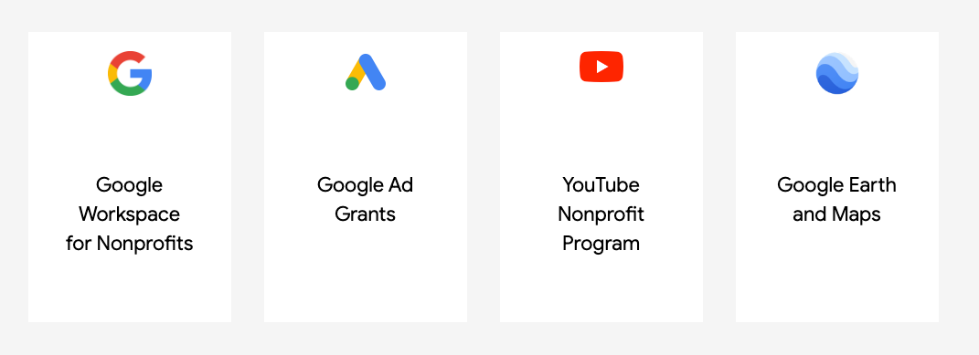
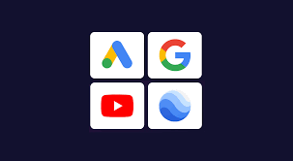
GOOGLE FOR NONPROFITS
Confirm that you meet the eligibility requirements
501(c)(3)
Request a Google for Nonprofits account
Once your nonprofit is verified, Google will let you know by email
Then you can activate and use the individual products

Slide 8
GOOGLE AD GRANTS
Raise awareness for your organization and recruit volunteers with in-kind advertising on Google Search
Ad Grants provides access to $10,000 USD, of in-kind advertising every month for text ads
Once approved, must maintain performance standards (exp. 5% CTR)

Slide 9
GOOGLE AD GRANTS
Who Qualifies:
Not a governmental entity or organization
Not a hospital or healthcare organization
Not a school, academic institution, or university (Google for Education offers a separate program for schools)
Organizations must be (i) registered with the IRS as exempt from federal income tax under Section 501(c)(3) of the US Internal Revenue Code, or (ii) a group exempt organization with proven affiliation to a central nonprofit that has 501c3 status

Slide 10
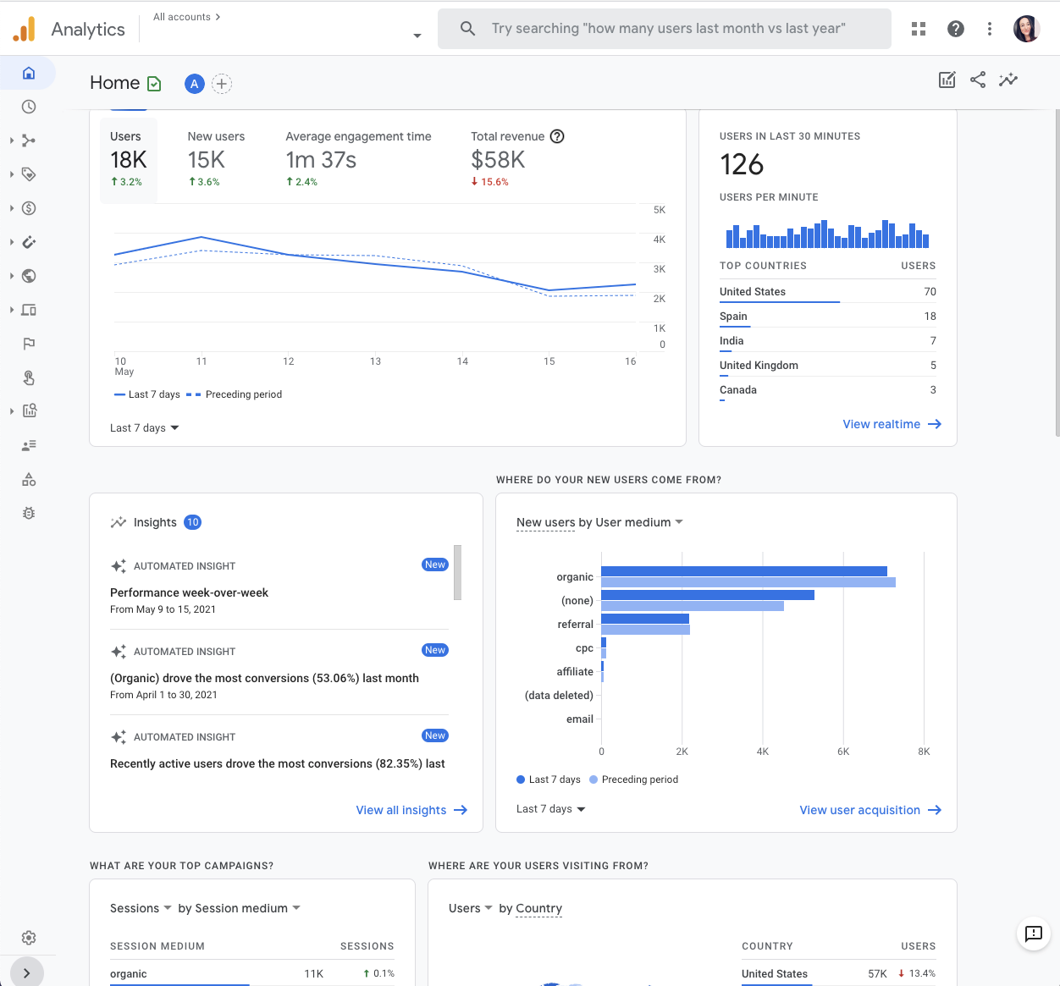
GOOGLE ANALYTICS 4
Measures Performance, based on real data; what’s working, what’s not and steps that can be taken to improve performance
A few items GA4 measures
Users
Sessions
Engagement Rate
Average Engagement Time
Views
Button Clicks
Event Count
Conversions
Conversion Rate
Attribution Paths
Other Digital Marketing Initiatives
Advertiser Ads Clicks
Social Media Detail

Slide 11
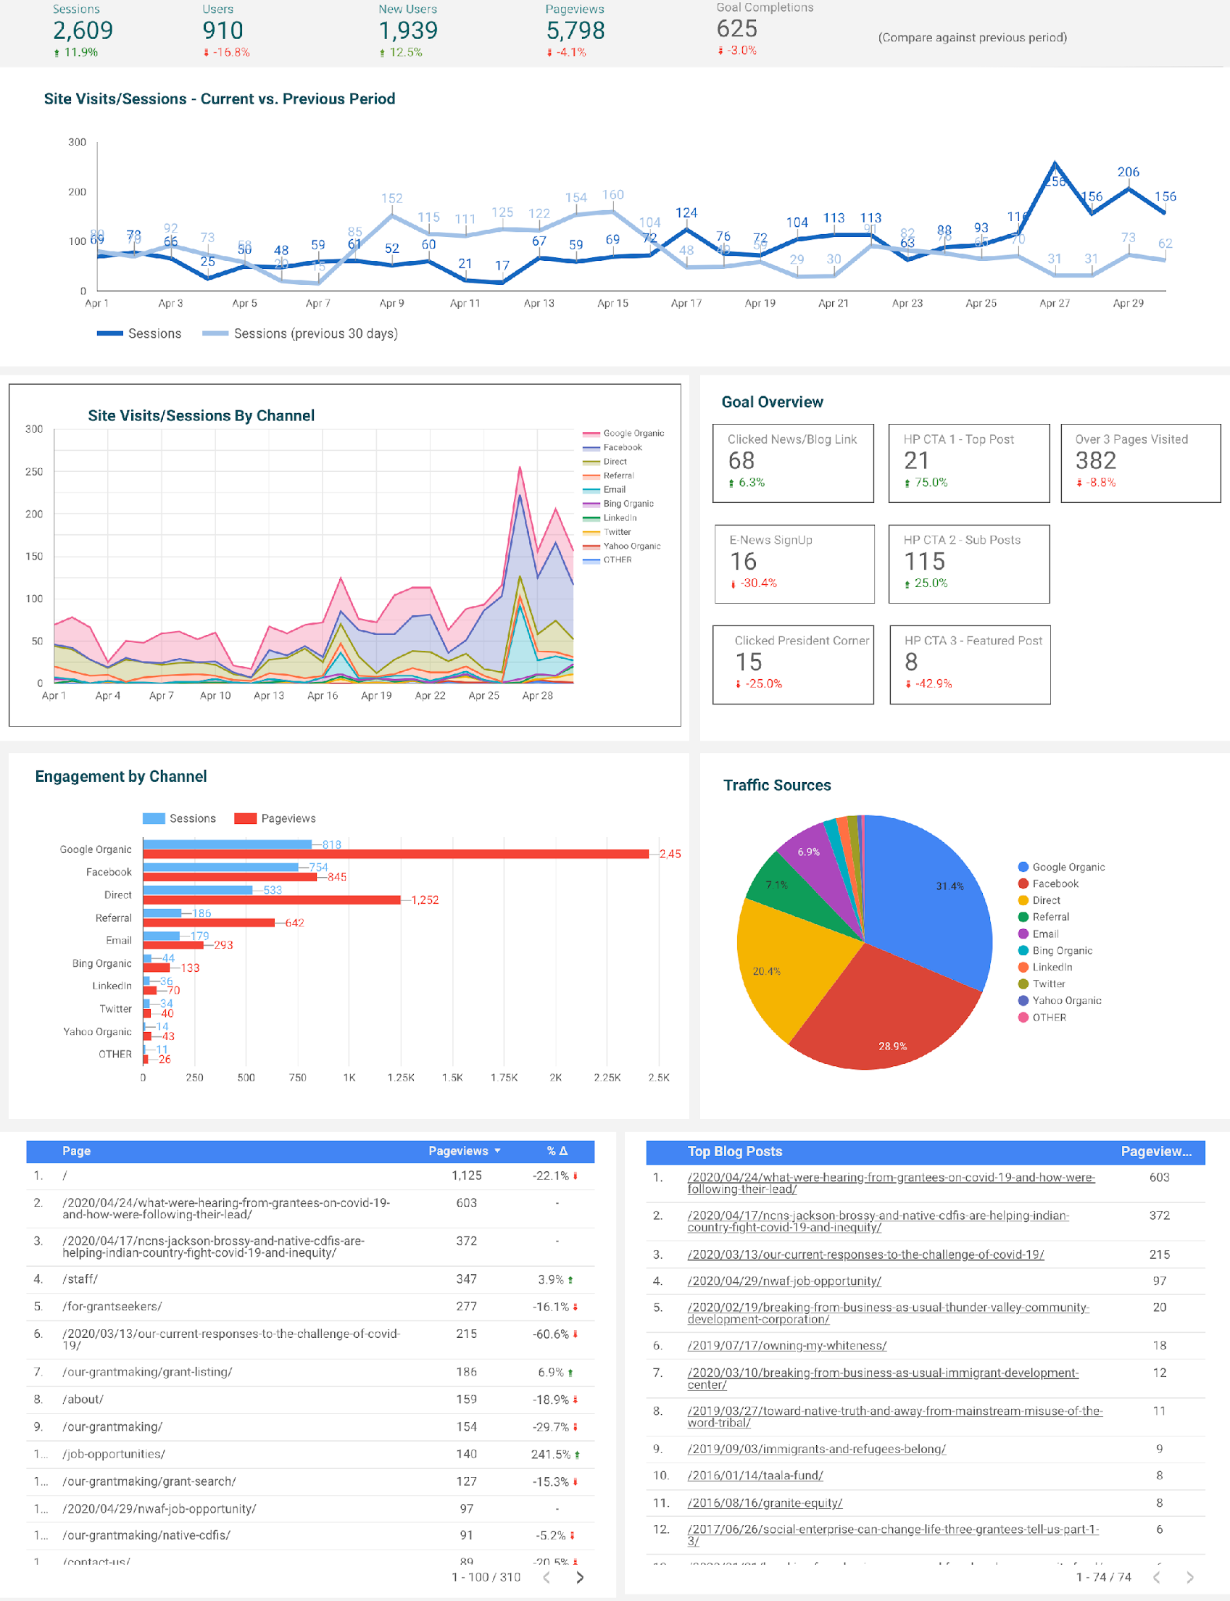
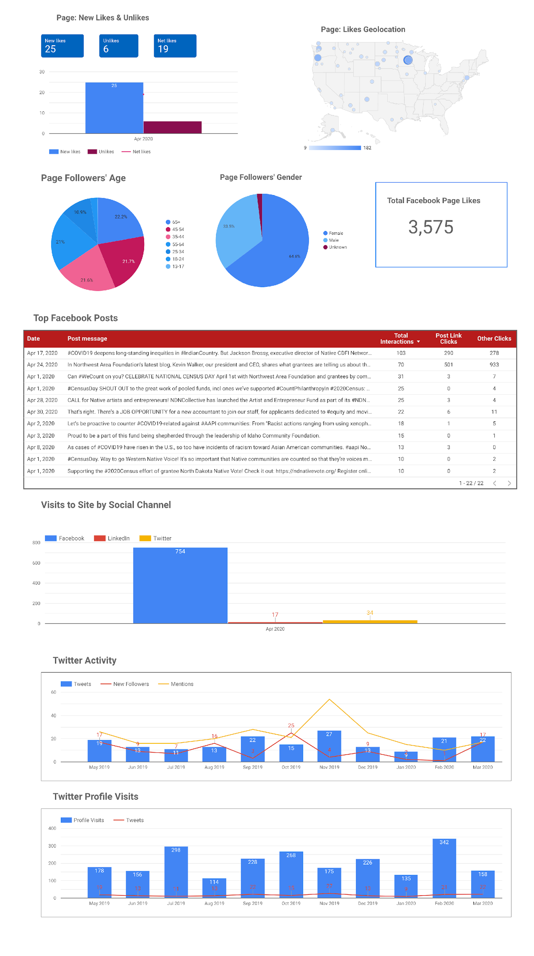
IMPLEMENT MARKETING DASHBOARDS
All Information In One Place

Slide 12
SOCIAL MEDIA
An Essential Arm of Your Digital Marketing Strategy
A Well-Planned Social Media Strategy Will:
Align with your business goals
Work in concert with and amplify other marketing initiatives such as Search, Content Marketing, PR, Events, Community Outreach, and more
Put your brand, story, locations and products in front of people in the places they already spend time
Help drive traffic and leads to your website, assist in sales and other conversions
Help to build your I email lists
Provide an opportunity to build and nurture a community while amplifying your brand
Include measurable tactics

Slide 13
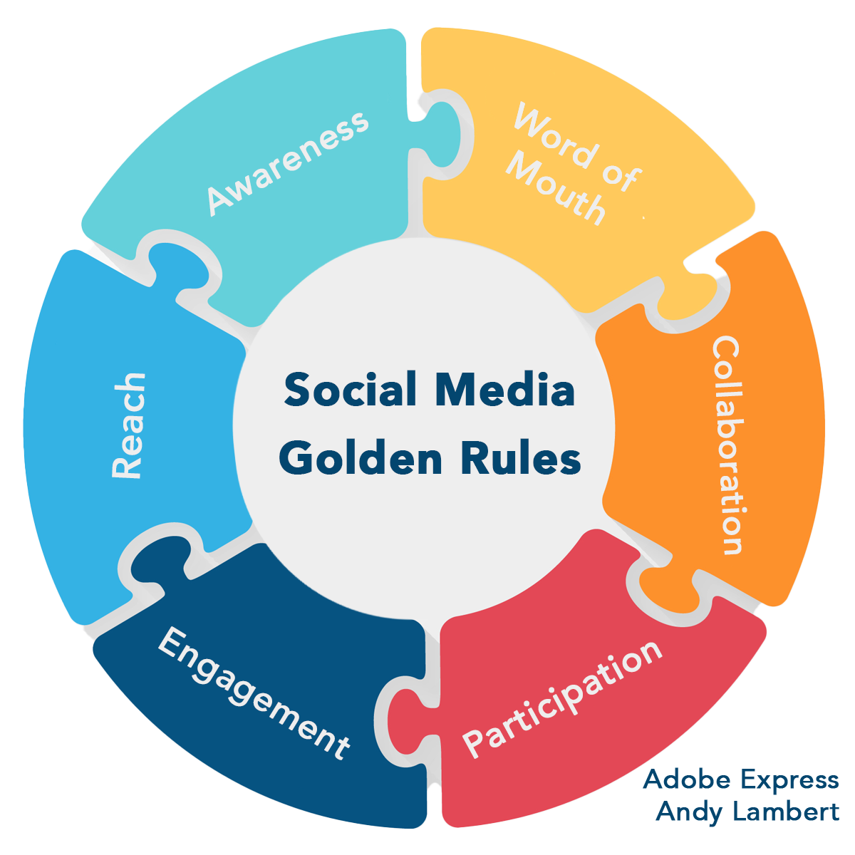
SOCIAL MEDIA
‘Golden Rules’ Wheel
Scaling ‘word of mouth’ is the goal
Collaboration increases opportunity
Participation increases engagement
Engagement drives reach
Reach drives awareness
Awareness: For most, the ‘best product/place/event is the one
they know

Slide 14
SOCIAL MEDIA
Define Your ‘Why?’
Create brand recognition, awareness, and authority
Grow a community around a topic you are passionate about?
Establish thought leadership and authority in your industry or area?
Learn how your community interacts online
Tell your brand story and promote your products and events
Provide customer service
Drive traffic to your website
Build your marketing list
55% of consumers discover new brands / establishments first through social media

Slide 15
SOCIAL MEDIA STRATEGY
It Starts With An Audit
List all existing social media properties and everyone that has access to them? Are all using strong passwords? When were they changed last?
Do a manual search inside each platform to see if additional properties exist that you weren’t aware of. This is more common than you might think
Are Business Managers & Advertising Accounts set up? Who owns them? Are your Pages associated with them exclusively? List all people that have access and the levels assigned to each. Review any credit cards associated with the accounts, are they current?
Are pixels and Conversion APIs in place on your website? What Custom Conversions are set up?
Review existing posts (and ad history if applicable) on each platform. Do you have content that can be repurposed? List the types of content and how each has performed.
Review the consistency of posts and ads. Were there certain days / times that performed better than others?
Review your existing followers - define demographics. Are certain people engaging with your posts often?
Review the engagement your brand participates in. Does your brand comment, share, like, follow, promote other accounts?

Slide 16
SOCIAL MEDIA
Identify Your Audience Groups
Visitor Centers and DMOs likely have several audiences to identify including:
Businesses like local hotels, restaurants, festivals, and retail establishments to promote
Local communities to build and nurture that will help promote events, establishments, and I community interest
Newcomers that will be coming to the area to establish trust and credibility with
Consider your area features: Are you known for resorts? Diversity? Food experiences? College town? Medical campuses?
Learn the types of content that each group wants to see and will be most useful to them; pair that with the types of content that each platform gives the best visibility to

Slide 17
SOCIAL MEDIA
Plan and Schedule Your Content
Plan for consistent posts each week
Provide value for the community you are building
Choose the social platforms that your audience groups active
Vary the type of content you post to learn what your audience will engage with
Scheduling posts is helpful, but don’t forget your own engagement and responding to comments and questions
Video is currently the focus for most social platforms
Look for opportunities to collaborate

Slide 18
SOCIAL MEDIA
Audience needs
Who will execute the platform tactics?
Time allotted for social content creation and community management
Expertise in graphic and video creation: in-house or outsourced?
Budget available for strategy execution
Is there already a brand style-guide in place or does one need to be developed?
Factors To Consider When Forming Your Strategy

Slide 19
SOCIAL MEDIA
Review your results frequently. Do more of what your audience is responding to as long as it aligns with your business goals.
Measure and Adjust

Slide 20
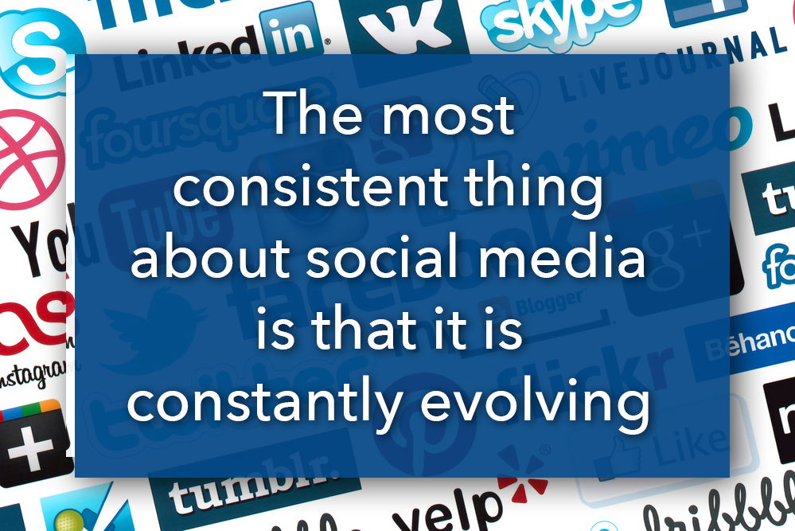
SOCIAL MEDIA
Social platforms are businesses, and they change goals, focus, partners, and terms of services when it suits their objectives. Businesses need to be aware that their social media tactics may need to adjust accordingly.

Slide 21
DIGITAL MARKETING TACTICS
The story of a rock…

Slide 22
DIGITAL MARKETING TACTICS
What you’ve just experienced is how stories add value to things - products, services, places..
The effect you just experienced was proven by marketers in a research project called the Significant Object Project.
Using storytelling methods, the SOP was able to increase the value of items for sale on ebay on average by 2,700% (not a typo).
Source: https://significantobjects.com

Slide 23
DIGITAL MARKETING TACTICS
What Is Content Marketing?
(Hint: It’s more than writing, although writing is a big part!)
Stories add value
Telling stories is creating content
“Content marketing is the process of creating and sharing useful online content like blog posts, guides, and videos to attract and engage customers.” - SEM Rush
Notes:
Quote source: https://smallbizclub.com/sales-and-marketing/its-just-science-why-stories-are-so-powerful/

Slide 24
DIGITAL MARKETING TACTICS
Content marketing has always been around, but the term was coined around 2011
Today, 90% of companies use content marketing
Content costs 62% less than traditional marketing
Leads from content are 6x more likely to convert
It’s perfect for destination marketing!
Source: NY Times

Slide 25
DIGITAL MARKETING TACTICS
You are marketing destinations filled with great stories!
Photos and stories of travel destinations share on social media
Blog articles about fun activities in a county or town
Tourism websites with downloadable histories or stories from the town
Videos showcasing local life

Slide 26
DIGITAL MARKETING TACTICS
Types of Content For Digital Marketing Storytelling
Blogs and blog posts
Newsletters
Case Studies
White Paper
Guidebooks, mini books, ebooks (downloadable stuff)
Videos
Podcasts

Slide 27
DIGITAL MARKETING TACTICS
How To Get Started
Let’s go over the handout and get you thinking about your content marketing strategy.
To Learn More:
Visit The Content Marketing Institute

Slide 28
DIGITAL MARKETING TACTICS
Local Search Marketing
Targets potential new customers in a local area
Google My Business
Optimized profiles
Relevance
Distance
Prominence
Online reviews helpful

Slide 29
SUMMARY
A Few Tips
The audit is key
Develop your digital marketing strategy
Focus on your target audience and business objectives
Who, What, Where, When, How
Will include social media
Content marketing a must
Consider Google AdGrants (501(c)(3)
Measure performance

Slide 30
Q&A

Slide 31
THANK YOU
We’re here to help!
Duane Coleman
Dashboard Interactive Marketing
763-242-2454
duane@dashboardinteractive.com
www.dashboardinteractive.com

