Slide 1
MACVB
Creating a
Crisis-Ready Culture
PRESENTED BY: ASHLEY ARAM

Slide 2
ABOUT GOFF PUBLIC
Public relations
Public affairs
Community engagement
Digital and creative services
Training and Coaching

Slide 3
WHAT IS A CRISIS?
A crisis is an event that:
Stops business as usual
Requires immediate escalation to leadership
Threatens material impact on people, environment, operations, reputation and/or the bottom line
Issues can become crises when someone else finds out and tells the story for you
Identify
Monitor
Plan

Slide 4
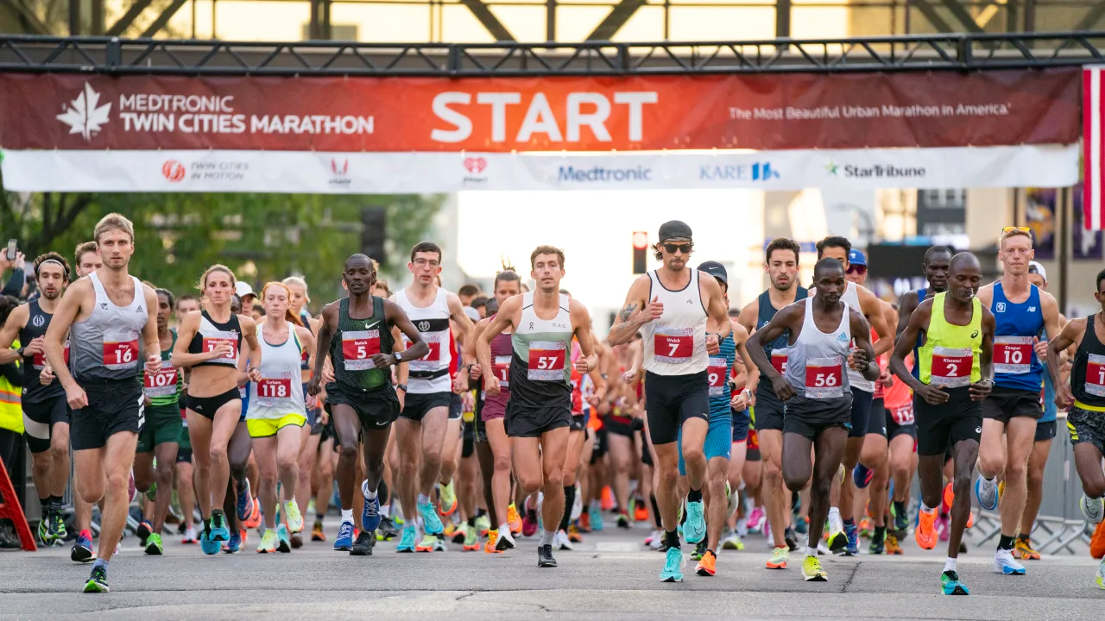
POTENTIAL CRISES TO PLAN FOR
Personnel issue
Natural disaster
Man-made disaster
Event cancelation
Controversial performers, speakers or conference hosts
Protest
High-profile issue related to a partner organization
Legal dispute
Pandemic
“Annual Twin Cities Marathon canceled due to extreme heat”
“Investigation details troubles with Minneapolis Black expo, lack of planning”

Slide 5
What can we learn from Terry?
Notes:
Fox News Reporter vs. Daycare Director - YouTube

Slide 6
A POORLY MANAGED CRISIS CAN
Damage your reputation
Result in significant financial costs (legal, PR, loss of revenue)
Erode trust with key audiences

Slide 7
YOU CAN WEATHER MOST CRISES WHEN YOU HAVE THE RIGHT RESPONSE
Organizations are measured more on how they respond to the crisis than the crisis itself

Slide 8
5-STEPS TO A CRISIS-READY CULTURE
1
Evaluate your crisis readiness
Make a plan
Practice
Build trust
Plan for regular maintenance
2
3
4
5

Slide 9
BUILDING YOUR CRISIS COMMUNICATION PLAN
Tip: This is different than an operations plan!

Slide 10
ESTABLISH YOUR CRISIS COMMUNICATION TEAM
Assemble a team with clearly defined roles and responsibilities
There are people taking action and others approving them
What are the types of people you should consider having on your crisis response team?
What do those relationships look like?

Slide 11
DEFINE OBJECTIVES
Determine the fundamental objectives of the crisis communication plan
Decide what your plan needs to achieve
Public safety
Reputation management
Business continuity
What else?

Slide 12
ASSESS THE RISKS
Identify potential crises that could affect your organization
Conduct a vulnerability audit to understand where your organization is most at risk

Slide 13
DETERMINE APPROPRIATE COMMUNICATIONS TOOLS
Verbal tools: More personal
Media interviews
Phone calls or meetings with public safety officials, elected officials, donors, or any other attendees, members or staff who were directly involved or impacted
Automated phone line messages or talking points for office
Press conferences

Slide 14
COMMUNICATIONS TOOLS
Written tools: More messaging control and can reach many key audiences quickly and simultaneously
Official media/public statement(s)
Email(s) to select audiences
Emergency notification system (call/text/email)
News release(s)
Website (custom banner at the top of the homepage, dark page, etc.)
Social media pages or volunteer Facebook groups
Employee slack channel
Signage at offices or brick-and-mortar locations

Slide 15
COMMUNICATIONS TOOLS
Each situation is different and should be considered on a case-by-case basis
Publications for proactive, positive communications shouldn’t be used during a crisis
Could be used to share information about longer-term responses or outcomes
Assess planned communications
Planned marketing and advertising (e.g. digital billboards, social media ads, etc.) can seem tone-deaf
Consider suspending these messages temporarily

Slide 16
PREPARE KEY MESSAGES
Pre-draft messages for different crisis scenarios
Ensure messages are adaptable to specific situations and are consistent with your company and brand values

Slide 17
DETERMINE YOUR AUDIENCES
Make a list of key stakeholders
Employees
Customers
Partners
Media
Plan how to address their concerns and how they’ll receive information

Slide 18
IDENTIFY AND TRAIN YOUR SPOKESPERSONS
Choose individuals who will represent your organization and messages publicly
Train them in media relations and message delivery

Slide 19
DEVELOP AND MAINTAIN MEDIA CONTACTS
Compile a list of media contacts to be used during a crisis
Build and maintain relationships with these contacts before a crisis occurs

Slide 20
CREATE HOLDING STATEMENTS
Develop general statements to use immediately after a crisis breaks, before all the facts are known
Public safety example: “We are aware of an incident [DESCRIBE IF POSSIBLE] at [LOCATION] and are working with [AGENCY] to respond. The safety of our [INSERT AUDIENCE] is our top priority. We will share an update soon as more information is available.”
Adapt the statement to the specific crisis situation as more information becomes available

Slide 21
PLAN FOR LOGISTICS
Arrange for a crisis management center if required
Ensure access to necessary communication equipment and technology

Slide 22
IMPLEMENT TRAINING AND SIMULATIONS
Train your crisis communications team by conducting regular crisis simulations
Review and revise the crisis communication plan after each training session

Slide 23
REVIEW AND REVISE YOUR PLAN REGULARLY
Schedule periodic reviews of your plan and update to reflect new risks, changes to your organization’s structure, and lessons learned from crisis simulations

Slide 24
COMMUNICATE YOUR PLAN
Make sure all employees are aware of your organization’s plan
Provide clear instructions of what to do if a crisis occurs

Slide 25
QUESTIONS?

Slide 26
THANK YOU
GoffPublic.com

