Slide 1
Introduction to Google Analytics 4
KYLE HUFF | DIRECTOR, GROWTH MARKETING, TEMPEST

Slide 2
Nice to Meet You
A LITTLE BIT ABOUT ME…
Director of Growth Marketing at Tempest
Former Content Manager at PHLCVB
Photographer
Passionate Philadelphia Eagles fan (Go Birds!)
Notes:
Intro

Slide 3
July 1, 2023
Notes:
I think we all know why we’re here today and have had this date of July 1, 2023 circled on our calendars for quite some time
Prepare to say farewell to the Universal Analytics tool you know and love…
Google will force a switch to their new Google Analytics 4 interface on July 1, 2023 — that’s only 60 days from today!

Slide 4
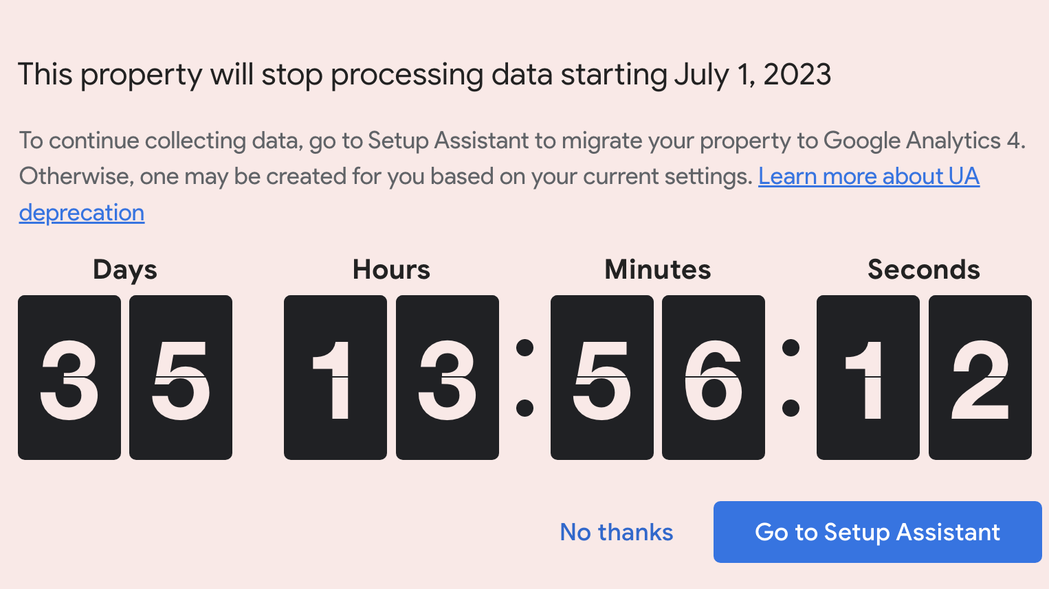
Notes:
Ominous countdown now live on GA

Slide 5
Notes:
Y2K Vibes

Slide 6
Notes:
While this is certainly a big switch — and one that has evolved and will likely continue to evolve up until it’s launch — there is not much cause for alarm.
Today, we’ll walk you through some of the top level changes that are occurring with the switch to GA4, and highlight how you can prepare for the switch right now to be ahead of the curb.

Slide 7
REMEMBER
Google Analytics 4 is a 100% new platform, not an update.
Notes:
Google Analytics 4 is an entirely new platform and is not just an update to existing Universal Analytics
REMINDER: Data in UA and GA4 is NOT 1:1 — new metrics, new data model, etc.
As we’ll highlight today, this new platform brings with it a few entirely new features, such as a new interface, new data model and new reporting metrics that DMOs will want to take note of

Slide 8
Why the switch?
THREE PRIMARY REASONS
Addresses privacy challenges faced by Universal Analytics (UA), which had data stored within Google Data Centers
The new tool also prepares users for a “cookie-less” and privacy-centric world
Built to report out on the complete customer journey, inclusive of mobile apps and other channels
Notes:
Let’s first look into some of the primary reasons for the switch to this new tool?
PRIVACY IS AT THE FOREFRONT OF GA4
Concerns in online privacy have only continued to rise in recent years.
Previously, Universal Analytics stored user data in Google Data Centers
Google needed to develop a new tool that was more in line with new privacy laws from around the world and how user data was collected, stored and measured.
GA4 is also about the holistic journey of the user…
including cross-platform journeys from desktop to mobile apps
GA4 was also developed with a mobile-first web experience in mind
GA4 ALSO USES MACHINE LEARNING — aka AI — to “fill in the gaps” of the user experience, having previously relied on cookies to help track
MACHINE LEARNING:
Develop automated insights
Detect anomalies
Generate predictive models
Better visualize trends to aid in campaign decision making
TAKEAWAY: GA4 should provide users with a more authentic and accurate reporting view moving forward

Slide 9
Spam & Bot Protection
In UA, spammers could send fake data to Google Analytics accounts to inflate numbers or deliver inaccurate results.
Google has fixed this problem by only allowing “hits” to your analytics report with a secret key to send data to a GA4 property.
Notes:
GA4 also helps protect marketers and their metrics from spammers and bots
Previously these could send “fake” data to Google to inflate numbers and deliver inaccurate results
Now, all hits are funneled through a secret key that transmits to your GA4 property
TAKEAWAY: Another way GA4 is providing more accurate user data

Slide 10
What’s the big deal?
Notes:
So, what’s the big deal?

Slide 11
What’s the big deal?
Universal Analytics will become “extinct” and stop reporting on July 1, 2023
Unprepared users will be confronted with new data models in Google Analytics 4 and may not understand the metrics
Additional data streams may not be configured properly, disrupting the ability to report on top KPIs
Notes:
Universal Analytics will become “extinct” and stop reporting on July 1, 2023
Unprepared users will be confronted with new data models in Google Analytics 4 and may not understand the metrics
Additional data streams may not be configured properly, disrupting the ability to report on top KPIs

Slide 12
Preparing for
Google Analytics 4
Notes:
There are a few steps that DMOs should take prior to July 1, 2023…

Slide 13
Preparing for GA4
OUR PLAN
Install Google Analytics 4
Identify key reporting metrics
Configure Google Analytics 4
Education yourself, your team and your stakeholders
Notes:
First, you need to install the Google Analytics 4 property to your business’ Google account
GOOD NEWS: In May 2021, Tempest began enabling the GA4 reporting property for existing Web and Growth destination partners.

Slide 14
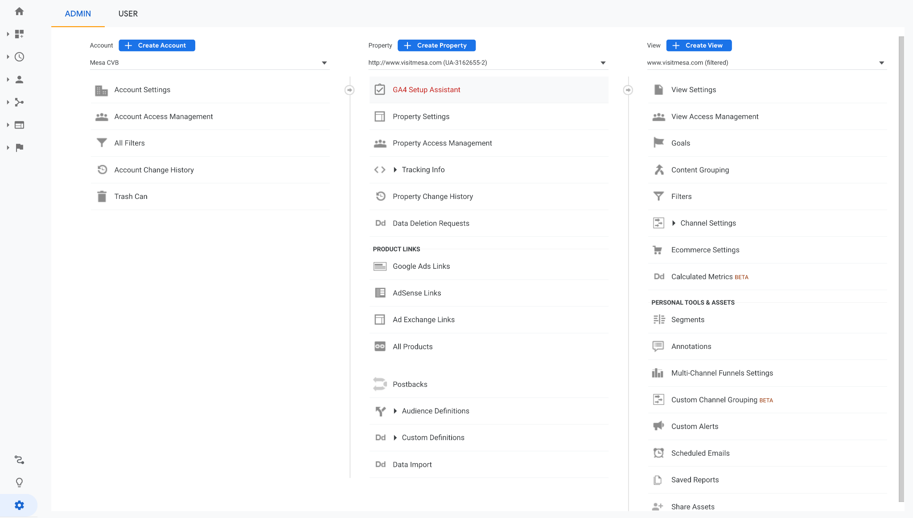
GA4 SETUP ASSISTANT
Found under Settings > Property > GA4 Setup Assistant within your Universal Analytics Property.
UNIVERSAL ANALYTICS PROPERTY SETTINGS
Notes:
GA4 Setup Assistant will walk you through the process

Slide 15
Preparing for GA4
OUR PLAN
Install Google Analytics 4
Identify key reporting metrics
Configure Google Analytics 4
Education yourself, your team and your stakeholders
Notes:
Next, you’ll want to identify the key reporting metrics you’d want to be able to quickly report out on
Identify where they can be found in an existing report, or edit the reports available to display
EXAMPLE: Tracking conversions, you need to mark them as such in order for GA4 to report on them accurately.

Slide 16
Preparing for GA4
OUR PLAN
Install Google Analytics 4
Identify key reporting metrics
Configure Google Analytics 4
Education yourself, your team and your stakeholders
Notes:
Next, you’ll want to configure GA4 to have the reports — with the correct metrics — that you’re aiming to report out on
Out of the box, some reports may need to be manually added/created/edited
Also look at enabling features like Google Signals, which will cover shortly

Slide 17
Preparing for GA4
OUR PLAN
Install Google Analytics 4
Identify key reporting metrics
Configure Google Analytics 4
Education yourself, your team and your stakeholders
Notes:
The final step here is to educate yourself, your team and your partners and stakeholders to some of the key differences within Google Analytics 4…and that’s why we’re here today!

Slide 18
Google Analytics 4
Crash Course
Notes:
Time for a quick crash course for Google Analytics 4
There are a few key differences important to note the few key differences between UA and GA4…

Slide 19
Google Analytics 4 101
THREE MAJOR DIFFERENCES
New user interface
New data model
New metrics
Notes:
THREE MAJOR DIFFERENCES
It’s a new user interface that looks similar to, but is entirely different from, UA
There is a also a new data model which impacts how data is measured in GA4 — event-based versus session-based
…and that new data model brings with it some new metrics — as well as a few familiar metrics with updated properties

Slide 20
New User Interface
Notes:
Let’s talk first, briefly, about the new user interface

Slide 21
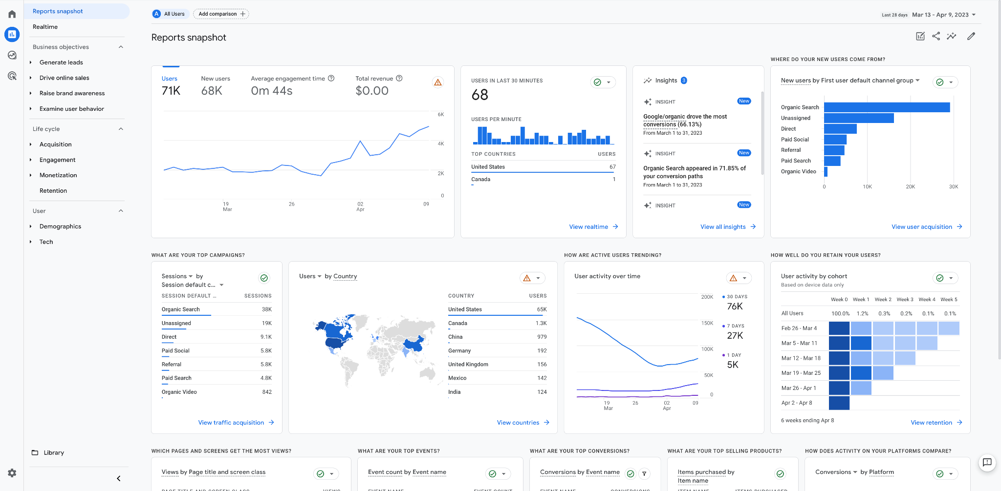
COLLAPSABLE RIBBON
Reports are accessed from a collapsable ribbon on the left side of the screen.
GOOGLE ANALYTICS 4 USER INTERFACE
Notes:
REPORTS HOUSED IN COLLAPSABLE RIBBON ON LEFT SIDE OF SCREEN

Slide 22
DATE RANGE
As in Universal Analytics, you can customize the date range in the top right hand corner, complete with period over period analysis options.
GOOGLE ANALYTICS 4 USER INTERFACE
Notes:
DATE RANGE CAN BE CUSTOMIZED SIMILARLY TO UA IN TOP RIGHT CORNER

Slide 23
REPORTS SNAPSHOT
This initial reporting view in GA4 provides a high-level overview of your top KPIs, campaign insights, user retention and more.
GOOGLE ANALYTICS 4 USER INTERFACE
Notes:
INITIAL REPORTS SNAPSHOT PROVIDES TOP LEVEL DATA, CAMPAIGN INSIGHTS AND TOP KPIS
CAN BE CUSTOMIZED, AS CAN ANY SCREEN/VIEW

Slide 24
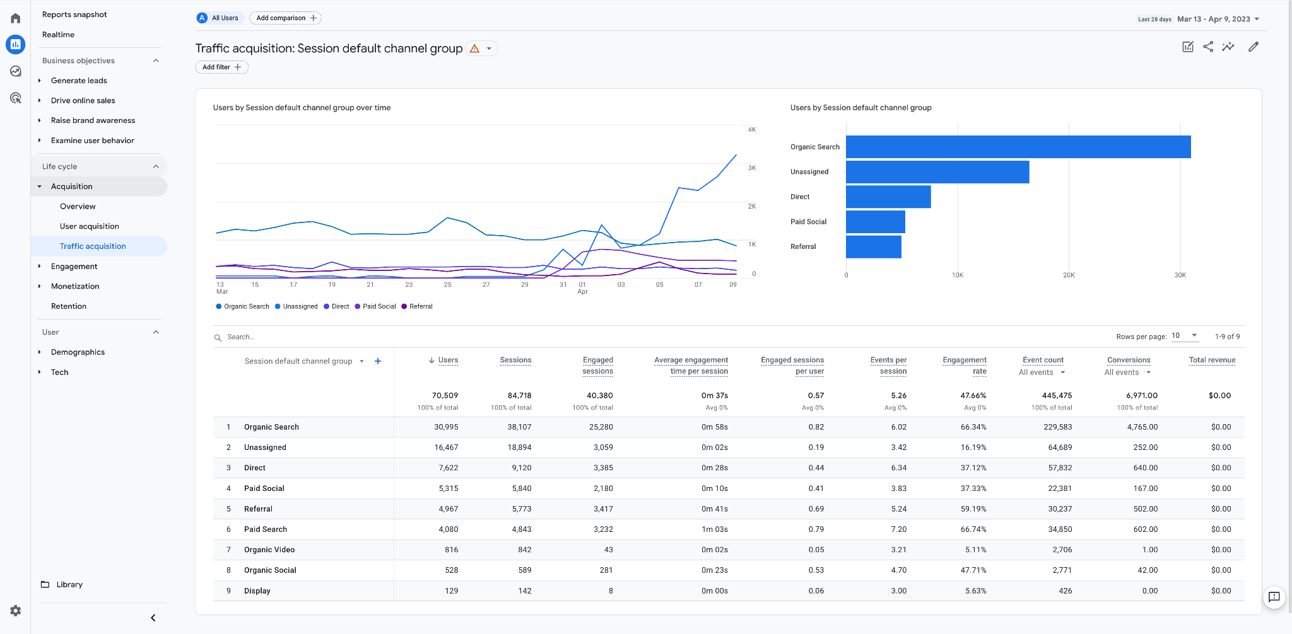
LIFE CYCLE
The default Life Cycle report collection contains information on user and traffic acquisition and engagement.
GOOGLE ANALYTICS 4 USER INTERFACE
Notes:
LIFE CYCLE REPORTS ARE THE BREAD AND BUTTER REPORTING FOR MOST DMOS
TRAFFIC, ENGAGEMENT, ETC.

Slide 25
ACQUISITION
Here is where you will find traffic data such as default channel grouping, sources and mediums, and top level performance insights for sessions, users, views and more.
GOOGLE ANALYTICS 4 USER INTERFACE
Notes:
WITHIN LIFE CYCLE
ACQUISITION HIGHLIGHTS WHERE USERS ARE COMING FROM

Slide 26
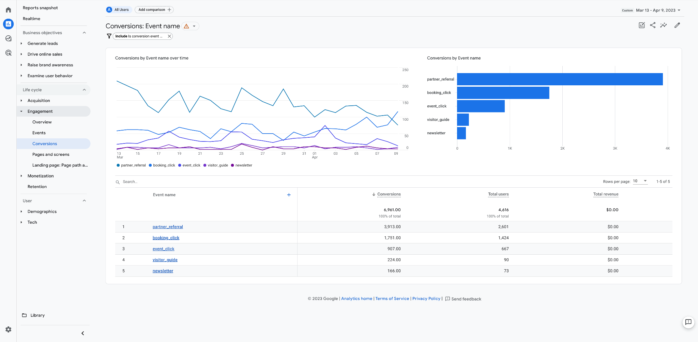
ENGAGEMENT
Here is where you will find user engagement data, including events, conversions and page-level insights into sessions, users, and more.
GOOGLE ANALYTICS 4 USER INTERFACE
Notes:
ENGAGEMENT HIGHLIGHTS HOW USERS INTERACTED WITH YOUR CONTENT
WITHIN ENGAGEMENT IS CONVERSION REPORTS, HOME TO YOUR TOP KPIs
CONVERSIONS MUST BE FLAGGED SEPARATELY

Slide 27
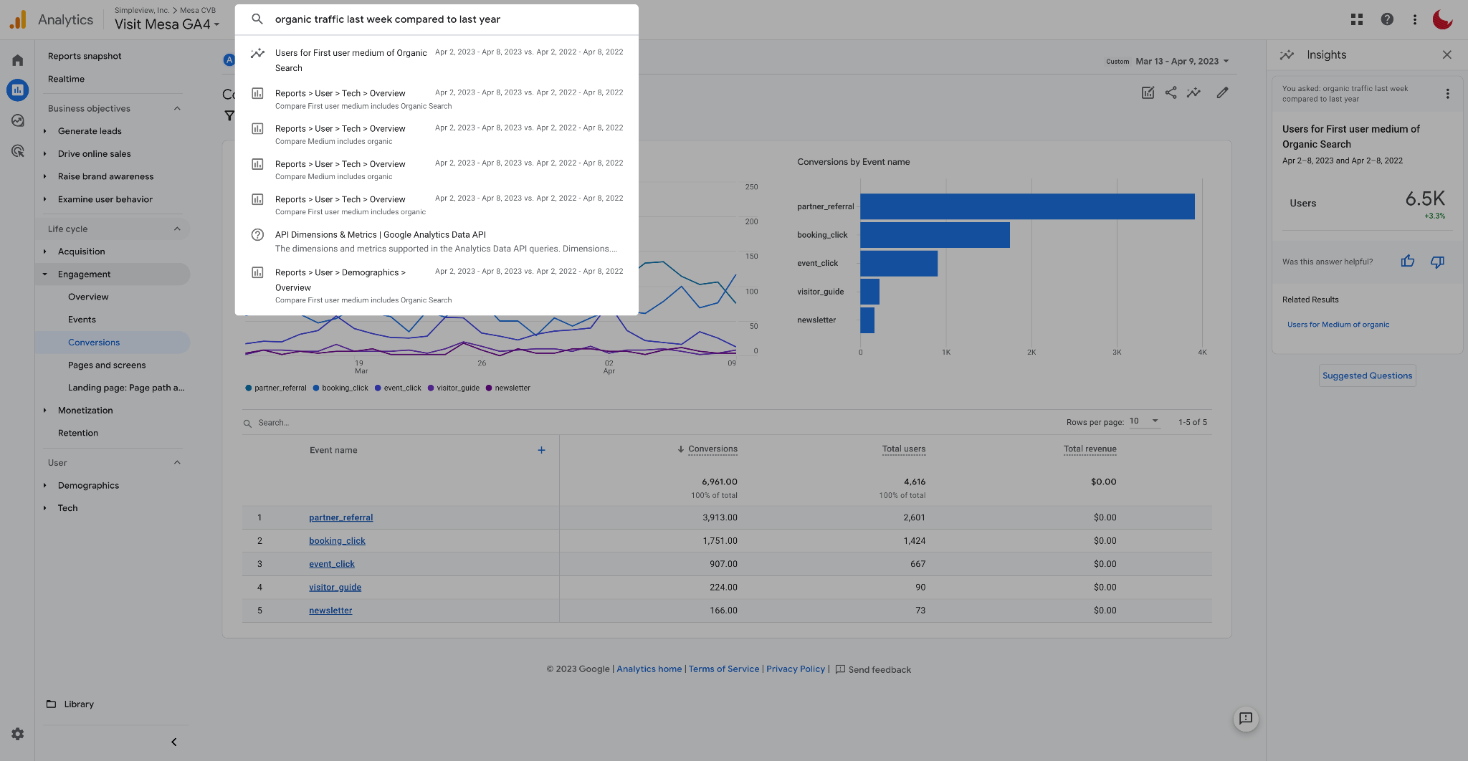
SMART SEARCH
A revamped search function allows you to quickly and easily search for specific metrics, comparisons and more, while returning immediate insights.
GOOGLE ANALYTICS 4 USER INTERFACE
Notes:
SMART SEARCH
PAID VS. ORGANIC TRAFFIC — Delivers live results on right side

Slide 28
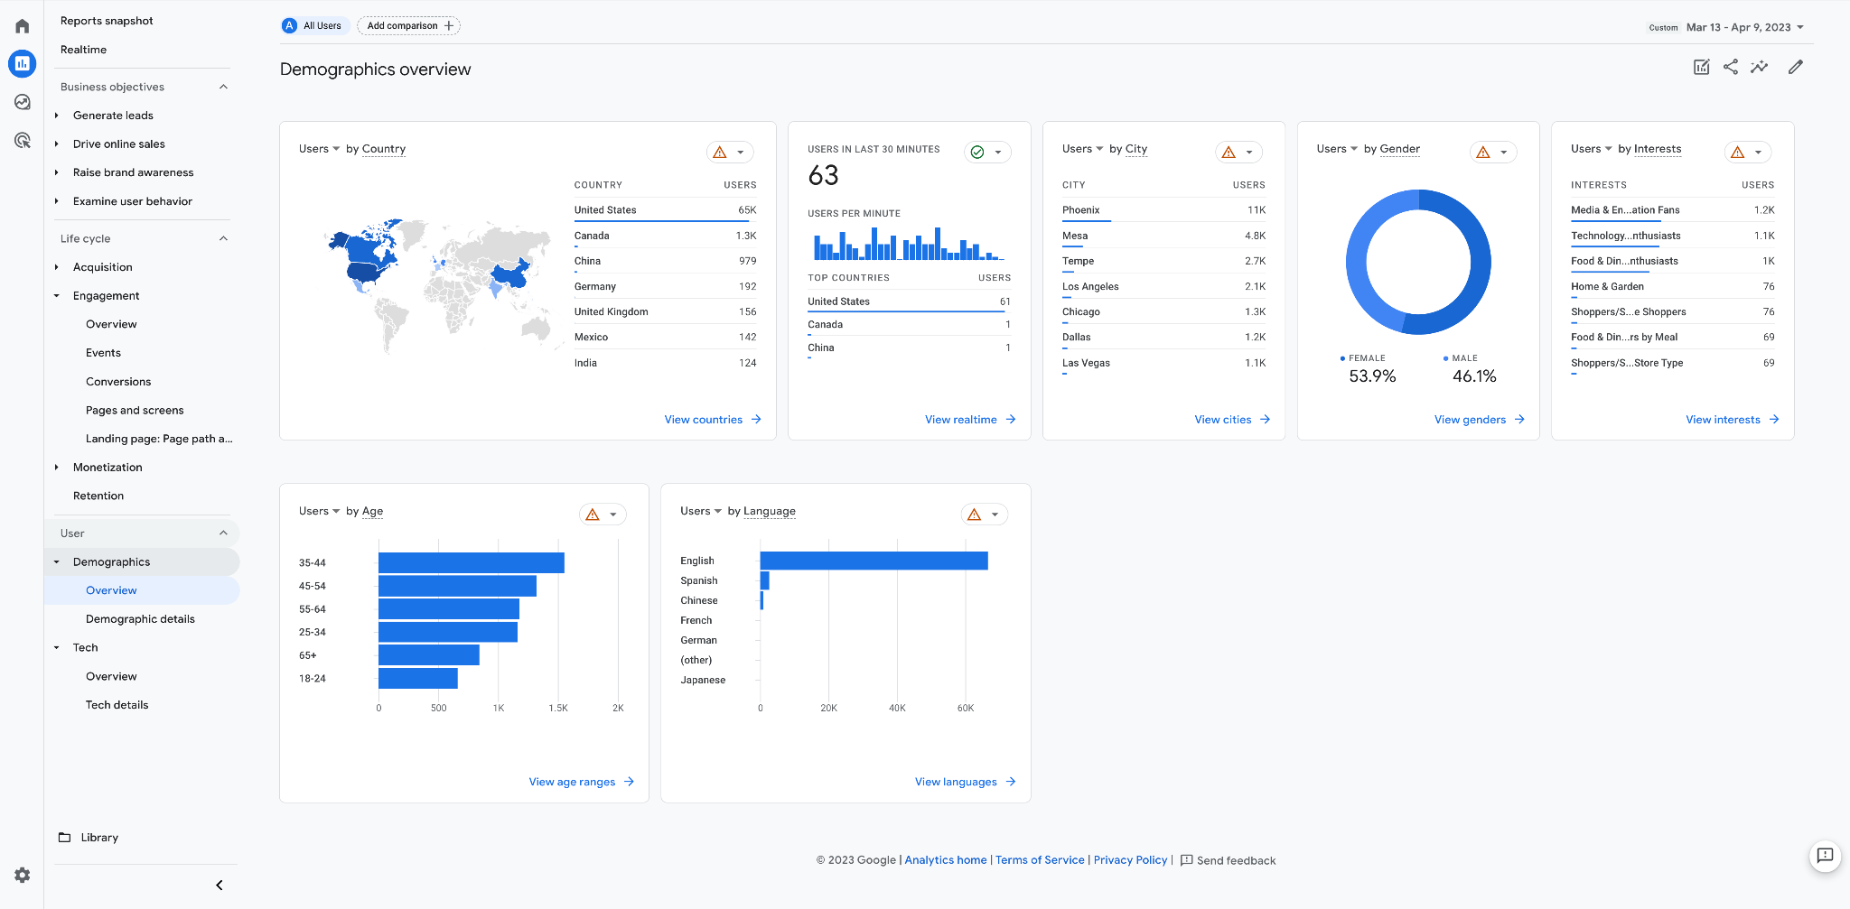
DEMOGRAPHICS
Here you will find audience insights for available demographics. These insights will be less specific than in years past due to updated privacy policies and user controls.
GOOGLE ANALYTICS 4 USER INTERFACE
Notes:
DEMOGRAPHIC REPORTS AVAILABLE WITHIN RIBBON AS WELL
CAUTION AGAINST ACCURACY DUE TO NEW PRIVACY CONTROLS

Slide 29
CUSTOM REPORTS
Google Analytics 4 allows users to develop custom reports to accompany or expand upon the out-of-the-box reports available to them.
GOOGLE ANALYTICS 4 USER INTERFACE
Notes:
CUSTOM REPORTS CAN BE CREATED AND ADDED TO THE RIBBON AS DESIRED

Slide 30
REPORT LIBRARY
All reports, including custom reports, are stored in the Library. From here, they can be viewed or added to collections such as “Life Cycle.”
GOOGLE ANALYTICS 4 USER INTERFACE
Notes:
ALL REPORTS, INCLUDING ADDITIONAL OUT OF THE BOX REPORTS (GOOGLE ADS) AND ALL CUSTOM REPORTS LIVE IN THE LIBRARY

Slide 31
New Data Model
Notes:
Beyond the user interface, another big change comes with the data model used in GA4 compared to UA

Slide 32
New Data Model
EVENT-BASED
GA4 USES AN EVENT-BASED MODEL to track user engagement with websites and apps, as opposed to the model used by UA, which was based around sessions and pageviews.
This is vitally important as it impacts the way in which data is presented — and interpreted — within GA4. This is also why UA data cannot be simply “imported” into GA4.
Notes:
Google Analytics 4 uses an event-based model to track user engagement on your website
Sessions will still be tracked, measured and reported on in GA4
Key difference here is that GA4’s metrics are more focused on users and their engagement with your website — be it loading a page, clicking on a link, playing a video, or more.

Slide 33
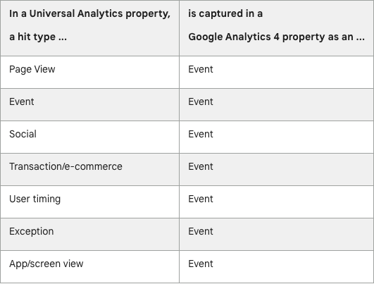
Notes:
GA4 = all hits on your website are tracked as events,
UA they were tracked as their own unique hit type
You’ll notice that yes — an Event in UA is also an Event in GA4 per this chart, however each has a key difference:
Event example in UA: Click event, forms, primary CTA
Event example in GA4: is the holistic data model of a user interacting with your website

Slide 34
New Metrics
Notes:
As a result of this new event-based data model, there are new — or slightly different — metrics in GA4 as compared to UA
There will not be 1:1 metric comparison due to this new data model.

Slide 35
Universal Analytics
TOTAL EVENTS
An event has its own Category, Action, Label and is its own hit type.
For example, registering that a sign-up button has been clicked, with a Category of “CTA”, an Action of “Sign-Up” and a Label of the destination URL.
Google Analytics 4
EVENT COUNT
All actions are events — every “hit” is an event and has no distinction of Category, Action or Label. For example, a view of your webpage is considered a pageview event.
Each event name is not necessarily unique, and it is a best practice to use the same name for similar actions across the site — like sign-ups — and differentiating them by the parameters collected.
Notes:
GA4 isn’t limited to form submissions and button clicks
GA4 events don’t have Category, Action or Labels for this reason.
All actions on your site are considered events in GA4 so we can better track user engagement.
Certains events are automatically in GA4 in, where others aren’t.
For example, first visits are automatically collected where outbound clicks aren’t.
Since certain events aren’t automatically, you’ll need to create conversion events for more accurate reporting. (We’ll get into that later.)

Slide 36
Universal Analytics
USERS
Total users was the primary user metric and was a measurement of total users on your website.
New users represented the number of users who interacted with your site for the first time.
Google Analytics 4
USERS
Total users represents the total number of unique users who logged an event.
New users represents the number of first-time users, but now includes both website and app usage.
Active users is the primary user metric and is the number of distinct users who visit your website or app and log an engaged session.
Notes:
Another key difference in metrics comes with the Users
The primary metric in UA is total users wherein GA4 its active users.
**Provide definition for each metric type.**
New Users is essentially 1:1

Slide 37
Universal Analytics
PAGEVIEWS
Total number of pages views, including repeated views of a single page.
Unique Pageviews represent the total number of pages viewed, but does not include duplicate views.
Google Analytics 4
VIEWS
Pageviews, or Views, measure the total number of app screens or webpages your users saw. Repeated views of the same screen are not counted.
As a result, Unique Pageviews are not tracked in Google Analytics 4.
Notes:
One thing to note for GA4 is that Unique Pageviews are not counted, putting more emphasis on the general Pageview metric, now just called “Views”
The major difference here is that in GA4 pageviews apply not just to total number of pages viewed, but also total number of app screens a user may have loaded, if you are using an app.
Repeated views of a single page are not counted, thereby eliminating the need of the unique pageview metric

Slide 38
Universal Analytics
SESSIONS
Period of time a user is actively engaged with your website or app, with defined parameters as to when it should end. These parameters include 30-minutes of inactivity, the timestamp being cut off at midnight or new campaign parameters.
New sessions start if:
User returns after a session timeout
User is on the website after the stroke of midnight
User picks up new campaign parameters on the website
Google Analytics 4
SESSIONS
Counted when a “session start” event is triggered, generating a session ID which Analytics associates with each event that occurs during the session.
Sessions end after 30 minutes of inactivity and are not restarted at midnight or upon new campaign parameters are reached.
If users return after a session timeout, it will result in a new session.
Notes:
Sessions are not that much different, however in UA a session is a hit type, in GA4 it is an event, as we highlighted earlier

Slide 39
Universal Analytics
CONVERSIONS/GOALS
You define a goal that indicates a specific user action to be considered a conversion, such as a “Form Submit” goal.
Only one of these goals is counted per session. For example, if a form is submitted twice during the same session, the submission will only count as one conversion.
Google Analytics 4
CONVERSION EVENTS
You specify a conversion event for each action you wish to count as a conversion. For example, if the “Form Submit” event is flagged as a conversion event, a conversion will be counted each time the user submits the form.
Every instance of the conversion event is counted, so if a user submits the form three times during one session, it will count three total conversions.
Notes:
Goals and conversions are specific user action such as a partner referral or form submission
In UA, goals/conversions are only counted once per session
In GA4, every single goal/conversion is counted within one session
**Provide example**
This provides more accurate reporting.

Slide 40
Is there a difference in YoY data between UA and GA4?
WE ANALYZED OVER 10,000,000 SESSIONS…
Users: +1%-5% in GA4 (avg 2%)
Sessions: +2-6% in GA4 (avg 3%)
Notes:
So with all of these changing metrics and data models, the question becomes
“What is the difference in data I can expect when comparing UA and GA4?”
The answer: minimal
We analyzed over 10,000,000 sessions for our DMO clients last year and noticed that on average, Users and Sessions both were a bit higher in GA4

Slide 41
Hello, Engagement Rate
Notes:
One of the key new additions to GA4’s metrics — and probably the most exciting addition, in my opinion — is the measurement of engagement rate

Slide 42
Engaged Sessions
AN ENGAGEMENT COUNTS AS ONE OR MORE OF THE FOLLOWING
Stayed on a page for 10 seconds or longer
Viewed more than one page
Triggered a conversion event, such as a video view, form submission or partner link click
Notes:
As we’ve already covered, GA4 has a strong focus on tracking events and user engagement throughout their journey on your website or app
GA4 tracks ENGAGED SESSIONS, which are when a user interacts with your page in one of a variety of ways:
Stayed on the page for 10 seconds or longer
Viewed more than one page
Triggered a conversion event, such as submitting a form or clicking a partner link
Think of engagements as a positive metric to report out on for your website
Much like someone saying “yes” to a proposal, here users are saying “yes” and engaging with your content

Slide 43
Engagement Rate
EVENT-BASED
GA4 MEASURES ENGAGED SESSIONS & ENGAGEMENT RATE to better highlight the journey of modern web users, and lives as a worthy alternative to bounce rate.
Notes:
GA4 then takes these engaged sessions and uses them to calculate engagement rate
Number of Engaged Sessions over the Number of Sessions over a specified period of time
Very similar to how some of you measure social media success — how many people are interacting with and consuming your content
EXAMPLE: if someone visits your website, is only there for a few seconds, but in that time gets the answer they need by loading a video or clicking out to a partner, would you consider that engaged session a failure? No.
Visitors are spending less time on one particular page or topic, as our ability to deliver information and answer questions has only improved
Engagement rate is by far — in my opinion — the most valuable new addition to GA4 and something to begin tracking and reporting out on
Engagement rate is measuring what went right versus what went wrong (with the latter being bounce rate)

Slide 44
What about Bounce Rate?
NOTABLE CHANGES
Still measured
The inverse of engagement rate in GA4
Not all bounces are bad
Engagement rate is a more valuable metric for our industry
Notes:
So let’s talk about Bounce Rate…
Bounce Rate was a top metric measured in UA and was the cause for concern for many a webmaster in previous years
Typically indicated a % of sessions that resulted in a single pageview without looking at a second page
But is that necessarily a bad thing? No.
I may have landed on your single page, gotten the info I needed, and moved on.
If anything, that is a positive as we were able to deliver the information the user was looking for
It is still measured in GA4
Bounce Rate in GA4 is a non-engaged session
In fact, these metrics should complement one another in most cases
If your engagement rate is 54%, then your bounce rate for that same reporting view is likely 46%
Still worth monitoring, but engagement rate is by far a more valuable metric for the travel and tourism industry

Slide 45
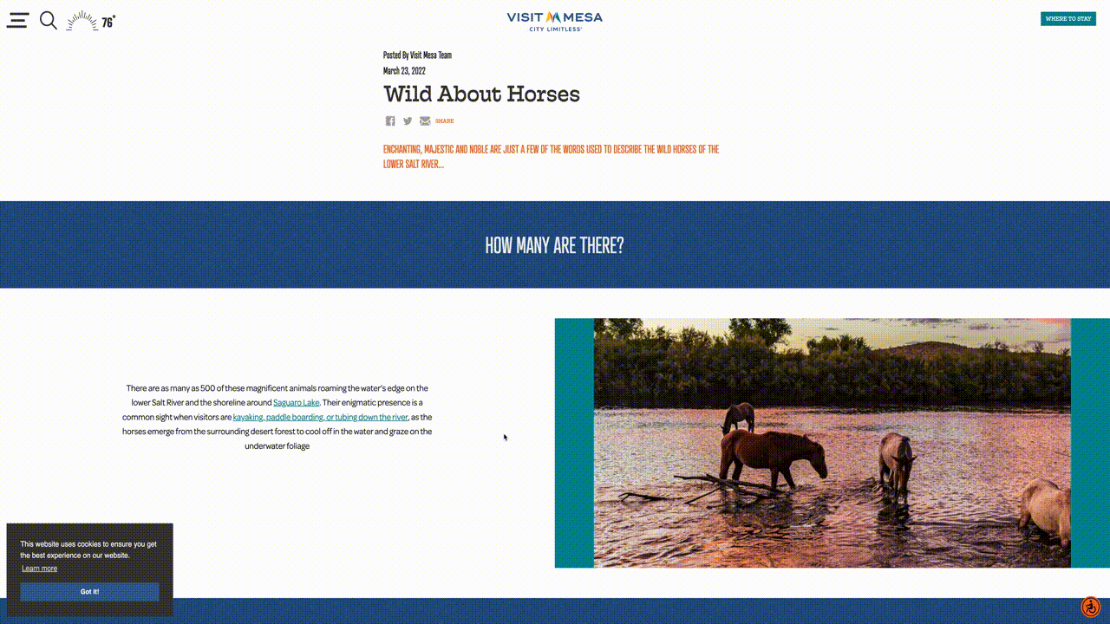
Notes:
KYLE
User clicks into this page, scrolls down, and finds the information they were looking for, or clicks a link out to a trail, partner or monument

Slide 46
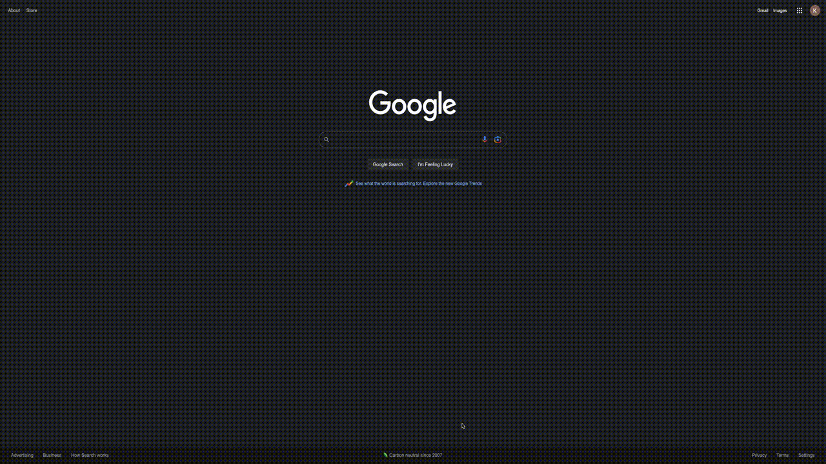
Notes:
Bounce rate example

Slide 47
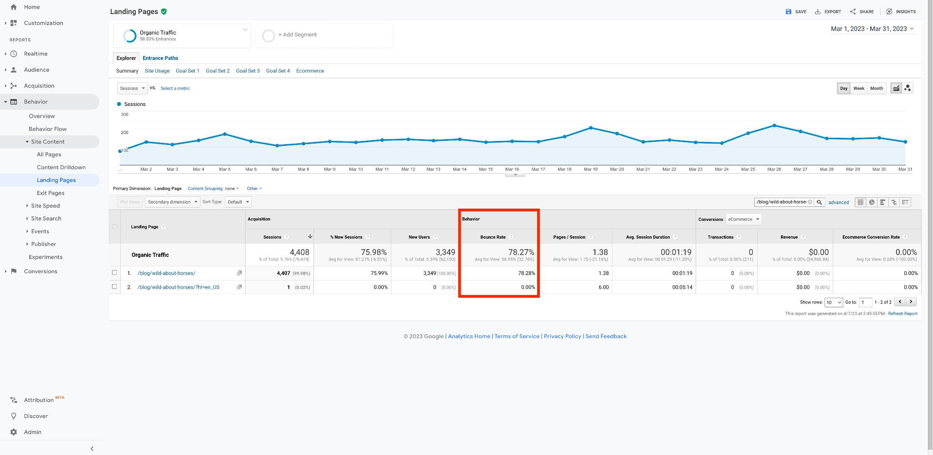
Notes:
You look at UA, and look at that bounce rate of 78% and say ‘wow’, no one is reading that page. It’s not resonating with the audience

Slide 48
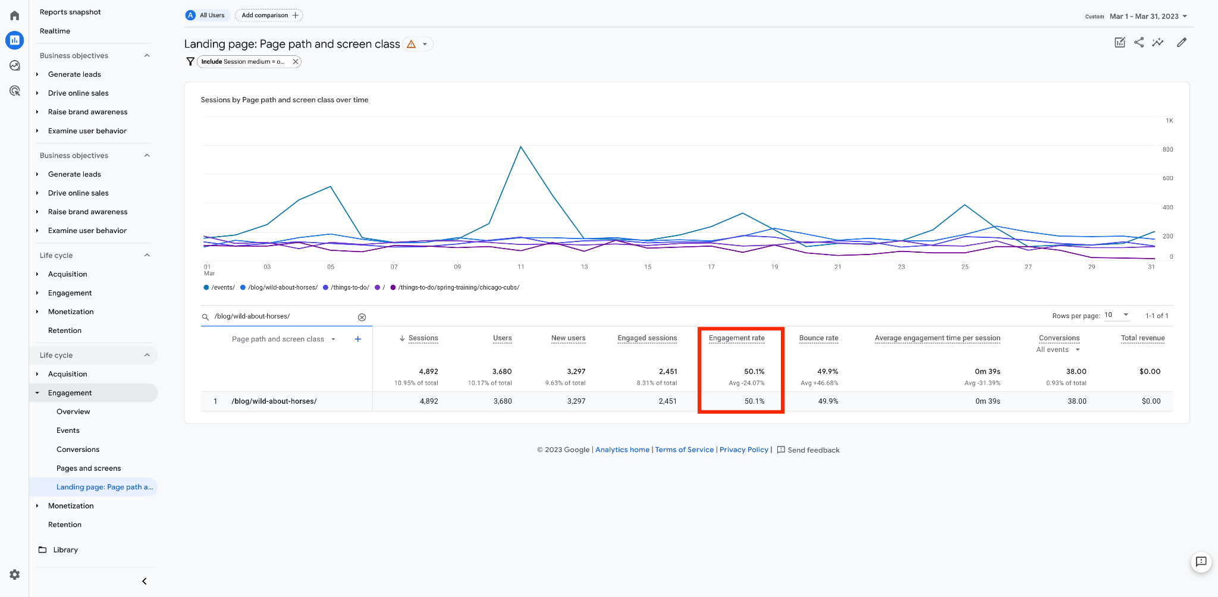
Notes:
But in GA4, that same page shows a 50% engagement rate.
It factors in time spent on the page, any external clicks, etc. providing us more context, and a better look at how people are engaging with our content.
45-50% is average for our industry — anything above that is above average

Slide 49
5 Things to Do
Right Now
To Prepare
Notes:
That’s a quick overview of the main differences in metrics.
There are a few things to flag that you can do RIGHT NOW to prepare for July 1 and GA4

Slide 50
Extend Event Data Collection Retention Period to 14 Months
Notes:
As a result of this heightened focus on user privacy, by default, event data collection retention in GA4 is set to only 2 months (!), but you can very easily update that retention period

Slide 51
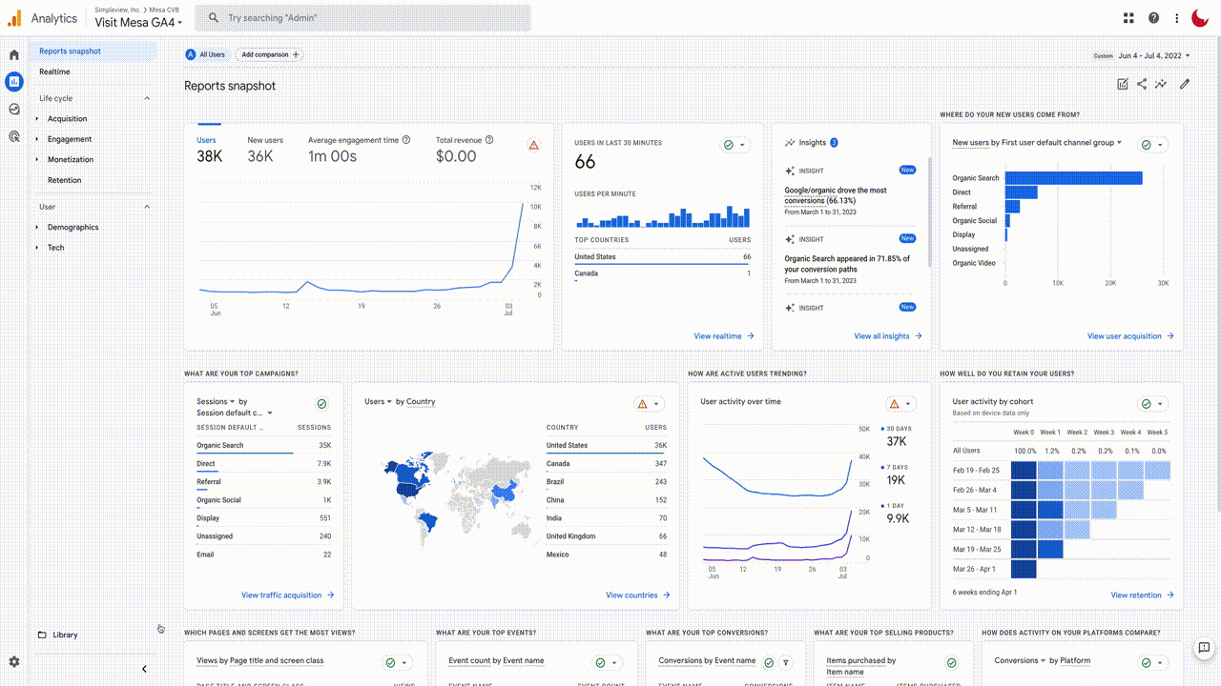
Notes:
In the settings for your property, under the Data Settings, you can easily update the retention period to 14 months
This means you’ll be able to retain user-level and event-level data, such as conversions
After the 14 month period, they are deleted automatically, but do not affect standard aggregated reports (including primary and secondary dimensions) in your Google Analytics 4 property
This has already been done for all Tempest Growth clients

Slide 52
Enable Google Signals
For Cross-Device Attribution & Increased Audience Insights
Notes:
Another — very easy — step to take would be to enable Google Signals for Cross-Device Attribution & Increased Audience Insights
By enabling Google Signals, you’ll be able to more effectively gain audience and demographic information
Applies only to users that are logged into Chrome and have opted in to this type of measurement
In the US, the Chrome share of browser usage is 46%.
While there may still be some audience segments whose data is protected — such as Apple Safari users — this small step should help provide slightly more accurate audience information in GA4

Slide 53
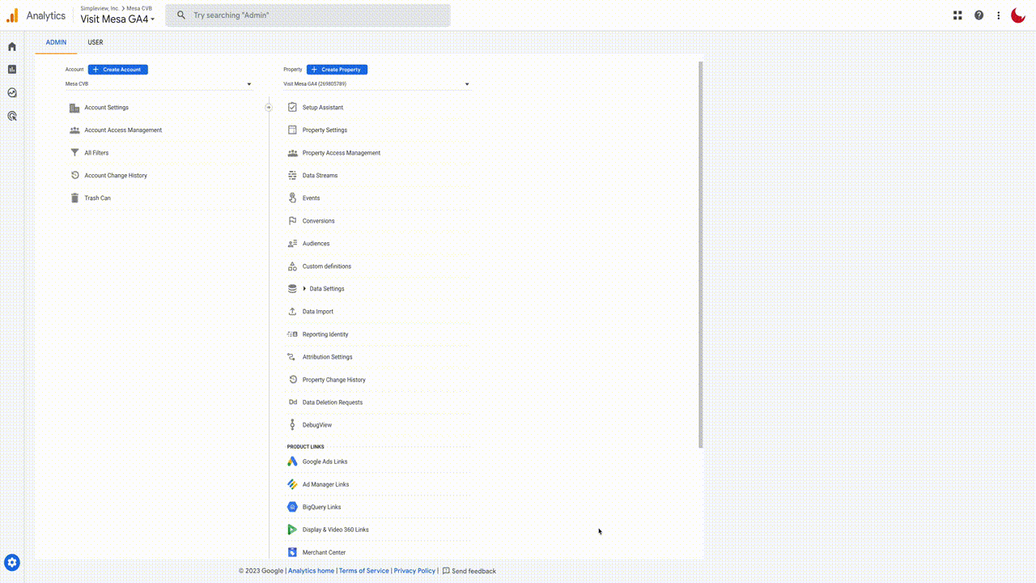
Notes:
This is done very easily under the settings of your Property, again under Data Settings
Just toggle on Google Signals Data Collection to opt in to this measurement ability

Slide 54
Mark Events As Conversions
Notes:
Another helpful step is to mark your Top KPI events — like newsletter signups — as conversion events in GA4

Slide 55
Notes:
This is also easy to do, so long as they are properly linked with your account and setup in GTM
First, under settings again, in the Events section, you should see a list of all events currently being tracked
A toggle on the right side allows you to flag specific events — these top KPIs — as conversion events
You can confirm these have been added and enabled — and manage them in the future — under the Conversions section of the Settings
Once properly enabled, these conversion events will be visible on the main reporting views

Slide 56
Notes:
SOALA
EXAMPLE OF WHERE CONVERSIONS ARE DISPLAYED IN GA4

Slide 57
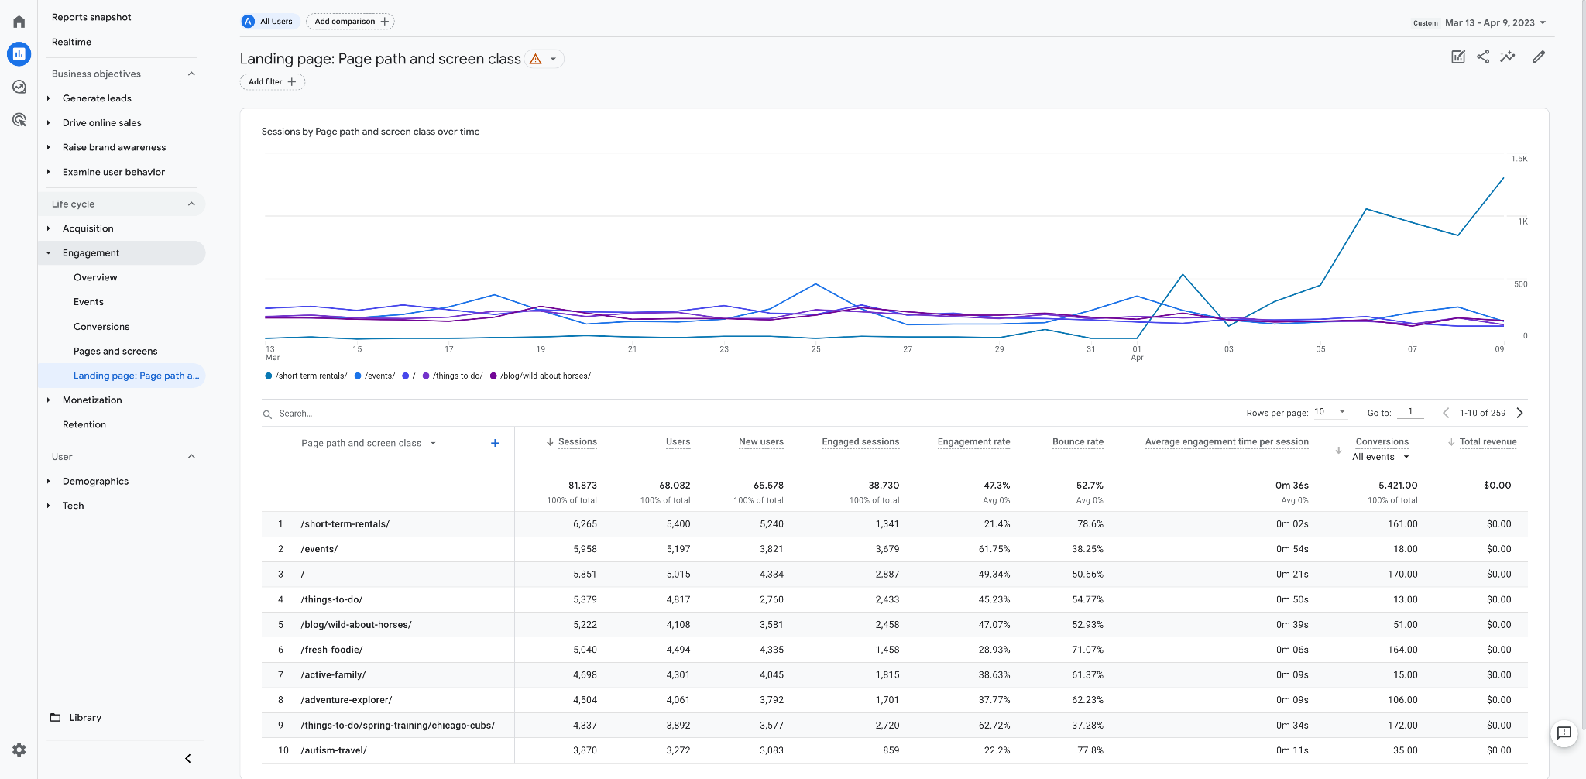
Notes:
EXAMPLE OF CONVERSIONS BEING REPORTED ON IN ANOTHER REPORT

Slide 58
Link Google Ads & Other Google Products
to Google Analytics 4
Notes:
You can also link your existing Google Ads account — and other Google products like Search Console — with GA4 easily in the settings under Google Ads Links

Slide 59
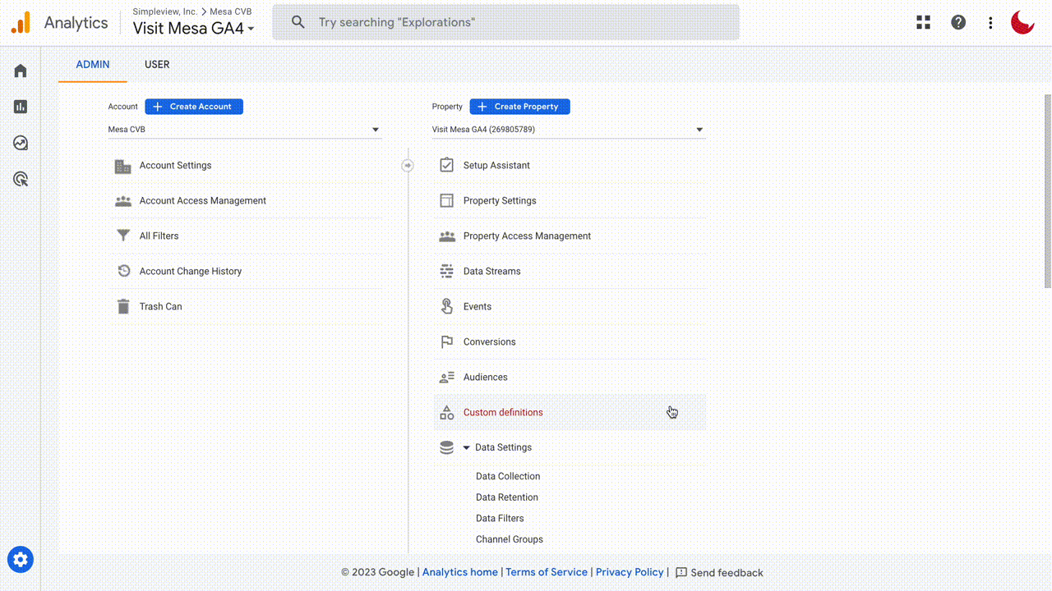
Notes:
Found under settings, scroll down

Slide 60
Build Custom GA4 Reports
Notes:
We also recommend that you build custom reports to make your workflow that much easier

Slide 61
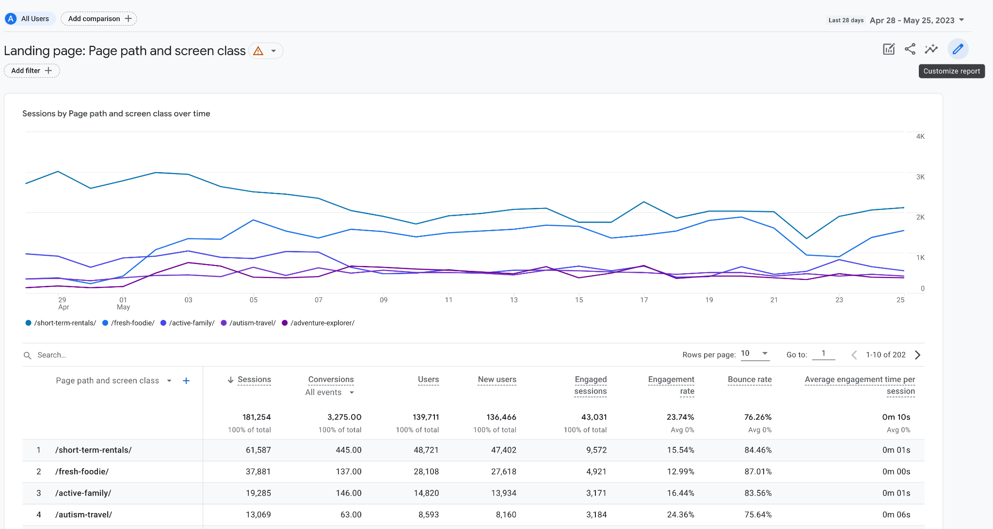
Notes:
Recommend starting with existing reports and either updating them, or creating new ones using them as templates

Slide 62
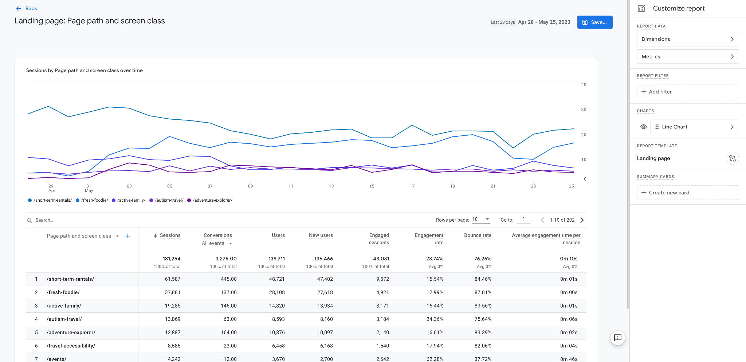
Notes:
You can customize just about everything in the report
Metrics, dimensions, filters (organic vs paid), presentation style and more

Slide 63
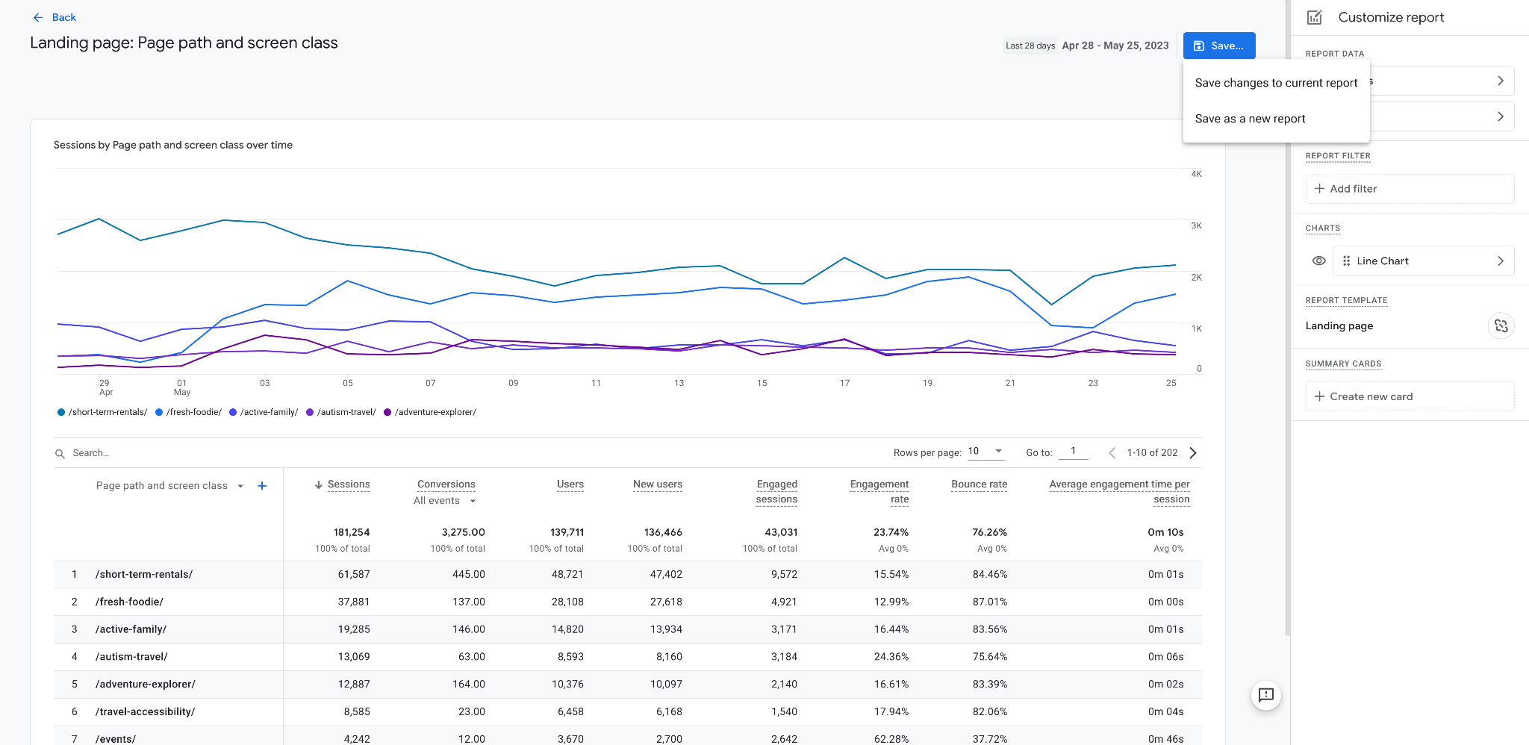
Notes:
When saving you have two options
BE CAREFUL with which option you select
You don’t want to save many duplicate versions of the same report

Slide 64
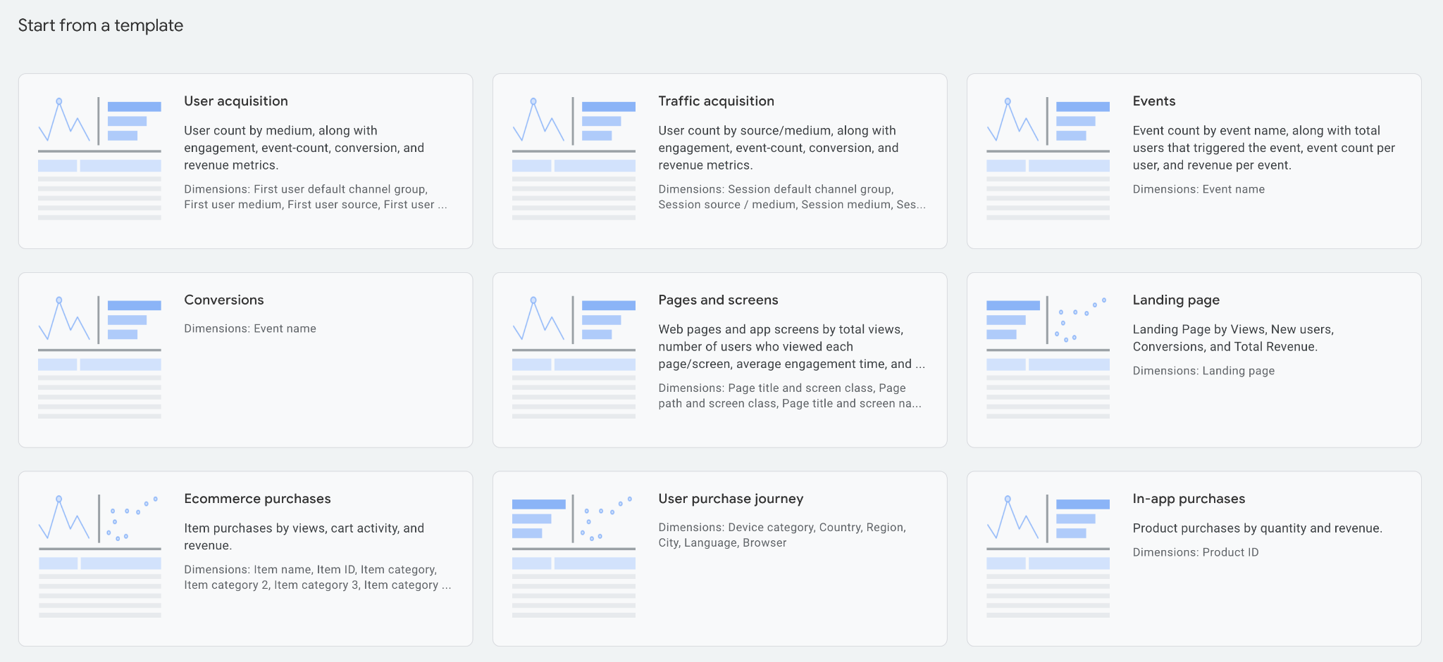
Notes:
A number of templates are also available within the Library

Slide 65
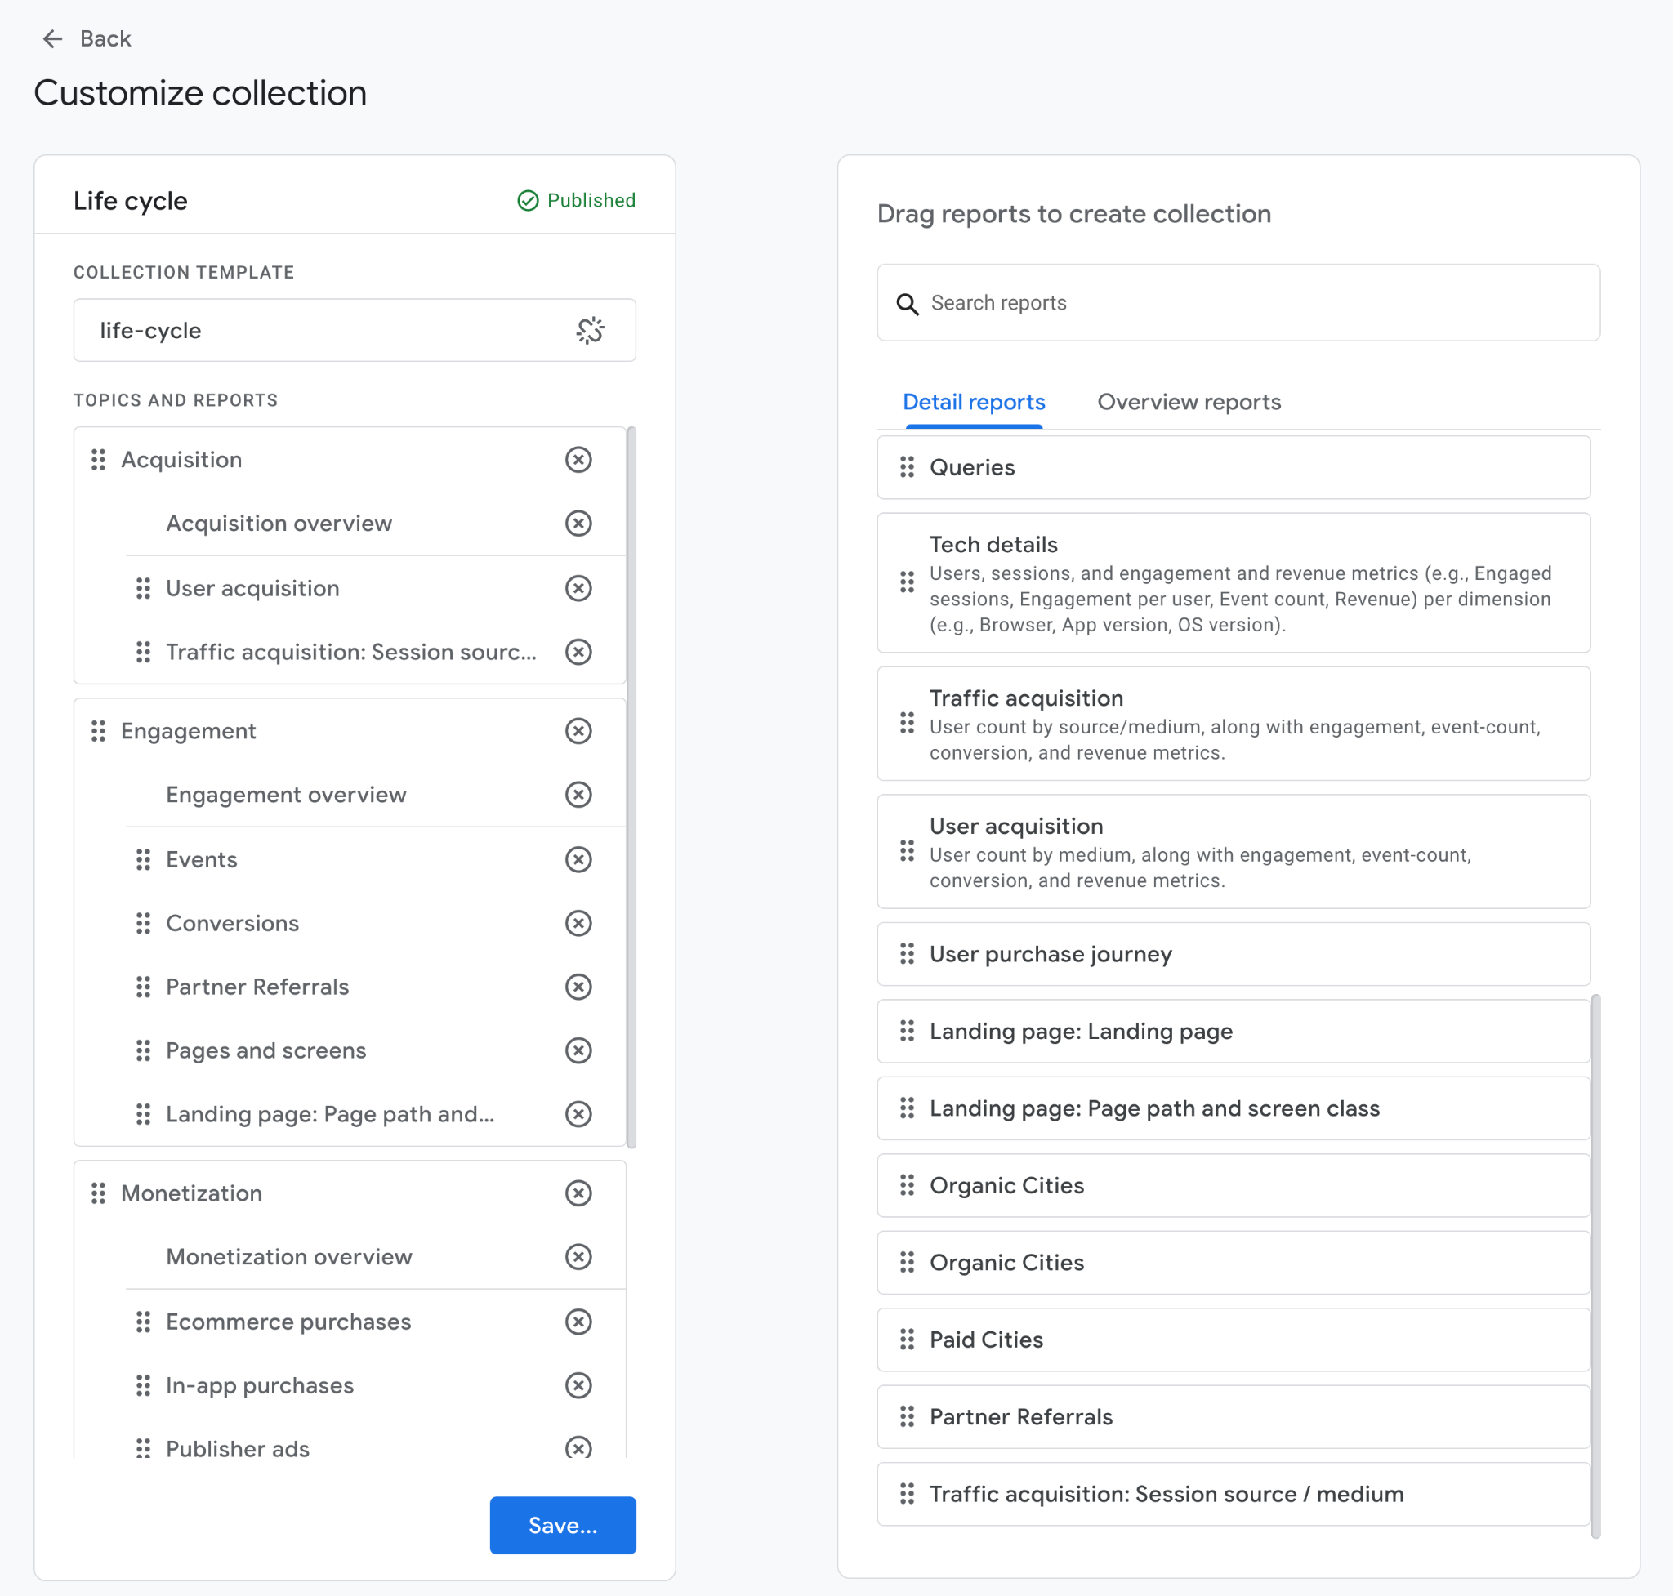
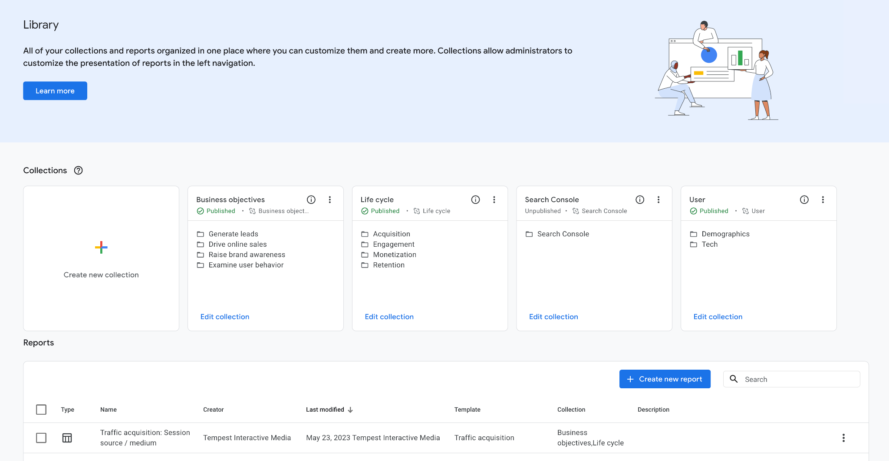
Notes:
Once the report is created, you can add to a collection (or create a new one) so that it is easily found within the interface

Slide 66
EXTRA CREDIT
Backup
Universal Analytics
Data
Notes:
KYLE
REMINDER: 6 months after that July 2023 date, Universal reports will no longer be available
If want to preserve that data for YoY analysis, you will want to store it using services like BigQuery, available to Analytics 360 subscribers only ($$$)
Or manual backup
NOTE: Not all data may need to be exported
Check what is in GA4 first, then see what you need to export or backup

Slide 67
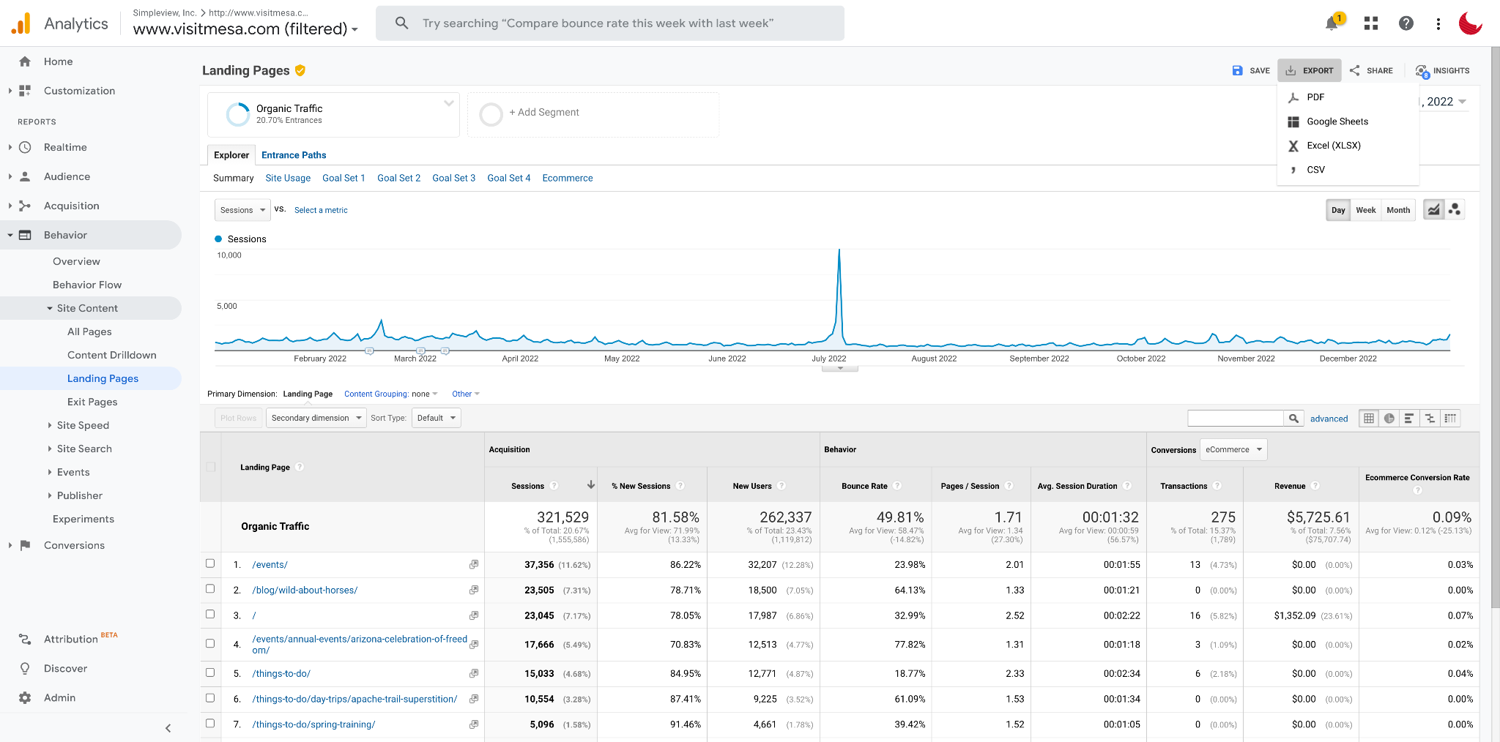
MANUAL DATA EXPORT
Manual data export is available for all reports within Universal Analytics and allows you to export data to a PDF, Google Sheets, Excel or CSV file.

Slide 68
EXTRA CREDIT
Verify Access & Ownership of Your Analytics Accounts & Properties
Notes:
Now is also a good time to go into the settings and verify who has admin — or ownership — access to your analytics properties
Share GA4 access with those that need it
Remove agencies, etc. that may no longer need access
Always make sure that YOUR ORGANIZATION is the owner of the main property/account

Slide 69
Helpful Resources
GOOGLE ANALYTICS 4 SKILLSHOP
https://skillshop.exceedlms.com/student/catalog/list?category_ids=6431-google-analytics-4
GOOGLE ANALYTICS 4 METRICS COMPARISON
https://support.google.com/analytics/answer/11986666
TEMPEST BLOG
https://www.tempest.im/blog/google-analytics-4-tips/
Notes:
KYLE
HELPFUL RESOURCES
DISCLAIMER — THINGS ARE ALWAYS CHANGING

Slide 70
Questions?

