Slide 1
Workforce Diversity, Equity and Inclusion (DEI)
Whitney Harvey
Sr. Director of Workforce Diversity and Inclusion

Slide 2
Workforce DEI
Workforce Diversity, Equity and Inclusion
The Minnesota Chamber is one of the first state Chambers in the nation to launch an innovative and unique diversity, equity, and inclusion (DEI) initiative. Consistent with the mission of the Chamber, the Chamber Foundation’s DEI initiative is designed to bring a simplified and attainable approach to diversity, equity, inclusion, and workplace inclusion and belonging by delivering practical solutions to business leaders

Slide 3
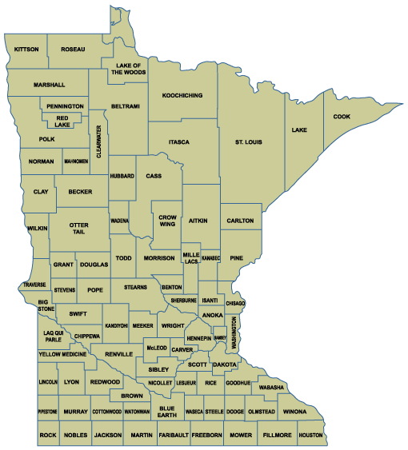


Workforce DEI: Surveying the landscape
57 businesses/community leaders
52 businesses
The discussion was designed to gather qualitative information from business leaders and community partners to assess the following outcomes:
The overall perception of DEI from the perspective of business and community leaders
To conduct a baseline assessment to understand where Minnesota is at as a state in terms of DEI
To understand the current barriers preventing advancement of DEI statewide
To identify the greatest opportunities and greatest need from the business community in terms of advancing DEI
Brainerd
Duluth
Willmar
Saint Paul
Shakopee
Austin

Slide 4
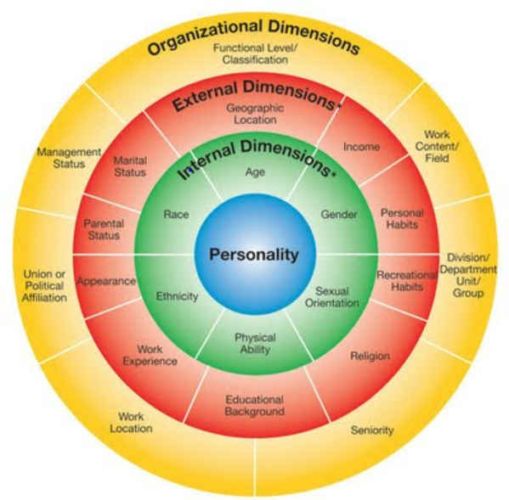
Workforce DEI: Identifying our opportunity
DEVELOP
Develop a comprehensive, Minnesota-specific repository of diversity, equity and inclusion resources and information.
CONNECT
Serve as a connection point for diversity, equity and inclusion-focused Minnesota businesses and community partners.
ADVANCE
Support the advancement, cultivation and preservation of a state business community that supports and commits to workforce DEI.
FOCUS
Focuses on all dimensions of diversity within all regions of Minnesota.

Slide 5
THE WHAT

Slide 6



Workforce DEI: Defining your terminology
The What
Diversity: Diversity is any category, characteristic, or dimension that is used to differentiate individuals from one another. This includes, but is not limited to age, gender identity, race, country of origin, religion, disability status, veteran status, and sexual orientation.
Equity: Equity is the creation of a fair and just environment that is free from bias and favoritism and ensures that all individuals are given the resources and tools they need to succeed, taking in to account individual needs. This includes but is not limited to access, status, and structural inequities.
Inclusion: Inclusion is the creation of an environment in which all individuals feel a sense of belonging, are respected, and are encouraged to present as their best authentic professional selves; Where unique perspectives, lived experiences, traditions, and cultures are seen as valuable characteristics that contribute to the richness of company culture.

Slide 7
THE WHY

Slide 8
Workforce DEI: The 3 imperatives
The moral imperative
The business imperative
The economic imperative
Notes:
Moral imperative and business imperative

Slide 9
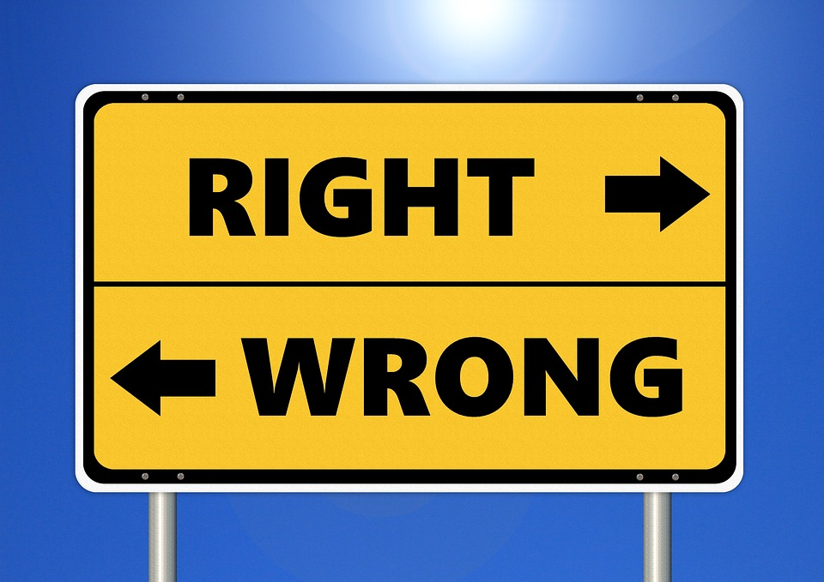
Workforce DEI: The moral imperative
Ethically and morally “right” to ensure every individual is treated fairly and respectfully regardless of race, religion, gender, sexual orientation, etc.

Slide 10




Workforce DEI: The business imperative
Businesses who prioritize DEI:
Are more innovative
Have higher retention rates
Have higher employee morale
Higher financial performance
Notes:
Moral imperative and business imperative

Slide 11

The economic imperative
Workforce DEI: The economic imperative
Changing state demographics
Negative net migration
Tight labor market
Underutilized/overlooked talent pools
  Build on strengths
  Leverage Minnesotans
  Strengthen communities
    Leverage and scale DEI efforts statewide
Notes:
Three strategies with actionable recommendations and growth acceleration opportunities that would strengthen Minnesota’s economy.

Slide 12
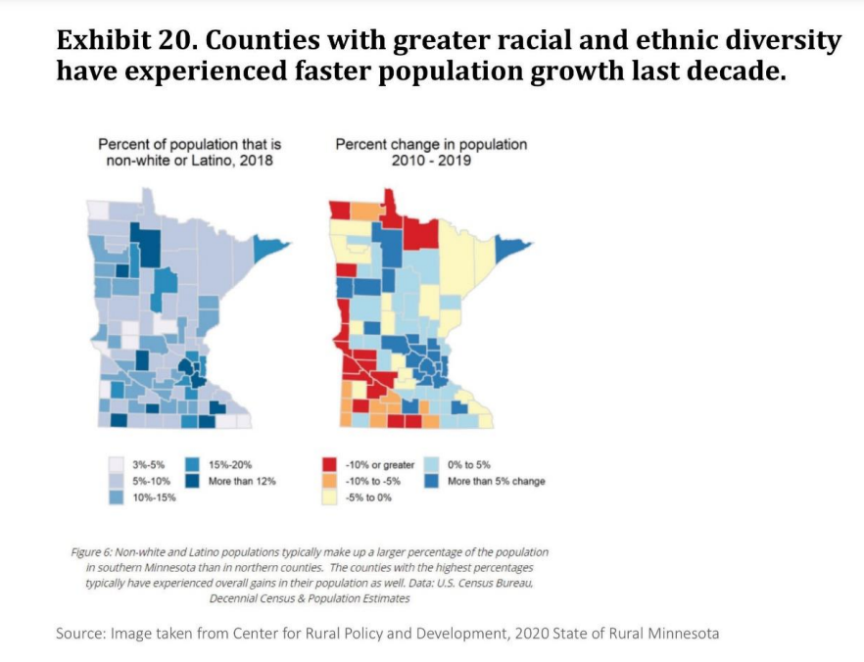
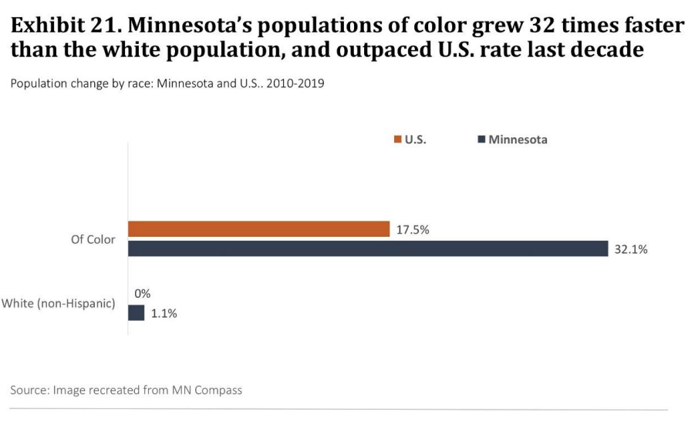
Workforce DEI: changing demographics
State demographics are changing
Notes:
While Minnesota’s total population is currently 78 percent non-Hispanic White, the racial and ethnic make-up of our population is changing rapidly. These projections indicate that statewide, Minnesota’s non-Hispanic White population has begun declining. Conversely, populations of Color are expected to swell by more than one million residents between 2020 and 2050—exceeding one-third of the total population.
Communities of Color are driving our state’s population growth and, as such, addressing these disparities will become imperative for the prosperity and quality of life for all Minnesotans.

Slide 13
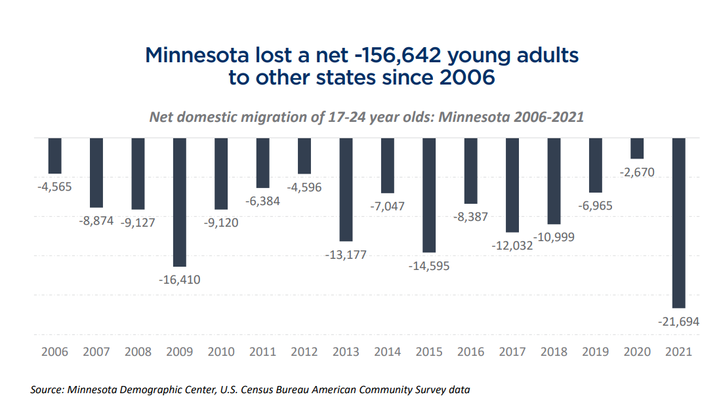
Workforce DEI: negative net migration

Slide 14
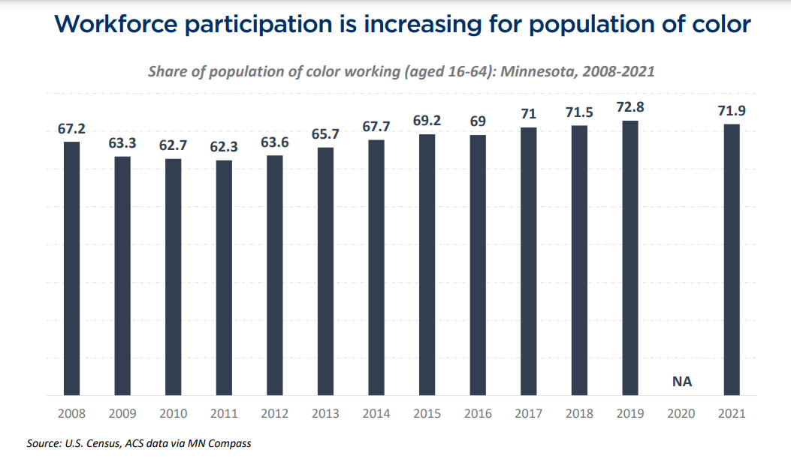
Workforce DEI: Workforce participation
Notes:
To sustain a healthy workforce, Minnesota must ensure that no one is left on the economic sidelines. Population growth has slowed to record lows in the U.S. due to declining birth rates over time. The U.S. economy had nearly 10.8 million unfilled jobs at the end of 2022, and job vacancies are expected to be a continued challenge going forward. Barring a reversal of fertility rates, immigration remains the primary mechanism to grow the nation’s population and ensure a stable workforce.

Slide 15
THE HOW

Slide 16

Workforce DEI
We have a very diverse environment and a very inclusive culture, and those characteristics got us through the tough times. Diversity generated a better strategy, better risk management, better debates, and better outcomes.
~ Alan Joyce
Notes:
Alan Joseph Joyce AC (born 30 June 1966) is an Irish-Australian businessman. He is the chief executive officer (CEO) of Qantas Airways Limited since 2008

Slide 17
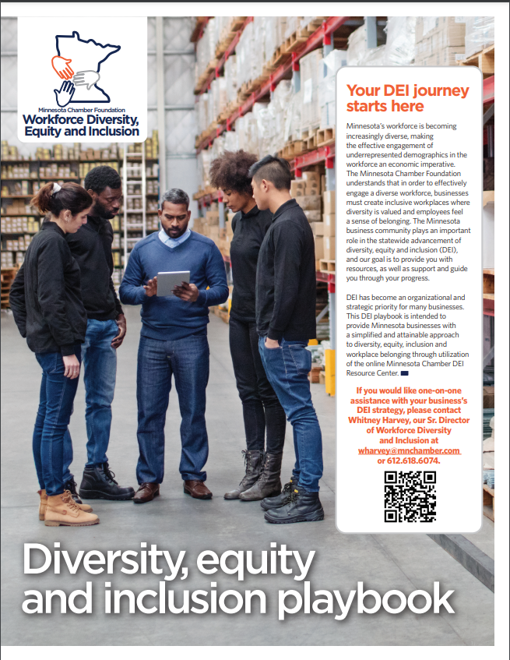
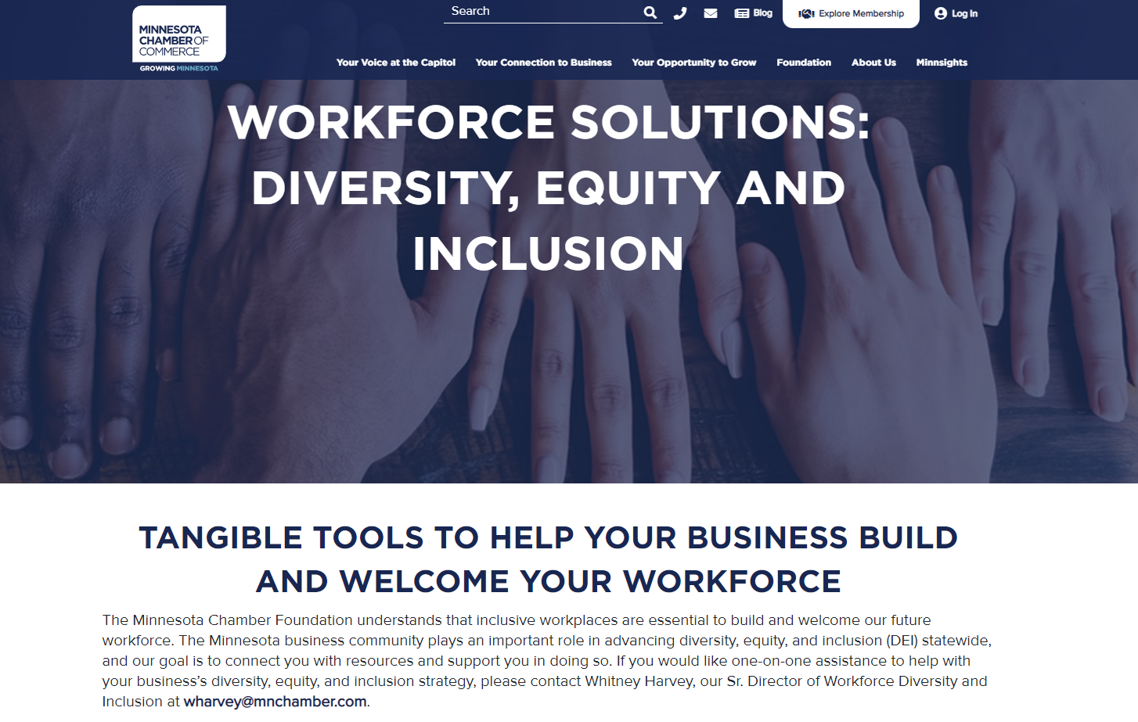
Workforce DEI: Chamber resources
DEI Resource center
DEI Playbook

Slide 18
Workforce DEI: The fundamentals
Lay the Foundation
Gather key stakeholders
Conduct an internal assessment
Build your strategy and implement
Hold yourselves accountable
Notes:
This will happen concurrently with the business best practice categories

Slide 19
Workforce DEI
Business Best Practice Categories
Recruitment/Retention
Community
Workplace programs
Supplier diversity
Training/ education

Slide 20

BEST PRACTICE CATEGORIES
Workforce DEI
Planning and Strategy
Implement overall DEI strategy
Identify where you are at in the journey
Monitor progress
Stay accountable
Review best practice categories to identify organizational opportunity
Use data and analytics to set goals

Slide 21

BEST PRACTICE CATEGORIES
Workforce DEI
Recruitment/Retention
Hire/retain diverse talent
Equitable job postings
Elimination of bias in the hiring process
Identify and recruit to diverse candidate pools
Employee onboarding
How to design new practices for recruiting

Slide 22

BEST PRACTICE CATEGORIES
Workforce DEI
Community Engagement
Connecting with community partners
Local community organizations
School boards/superintendents
Philanthropic giving
Local chambers
Municipalities
Other philanthropic groups
Non-profits

Slide 23

Workforce DEI
Supplier diversity
Develop business partnerships with diverse suppliers
Set goals
Establish vendor requirements
Partner w/ GrowMN
Acknowledge MBE certifications

Slide 24

BEST PRACTICE CATEGORIES
Workforce DEI
Workplace programs
Develop Internal programs that promote DEI in the workplace
Conduct a cultural assessment
Launch internal programs
Sponsorships
Internships
Implement inclusive internal policies (cultural competencies, respect)
Inclusive on/off boarding
Volunteer time-off
Mentorship

Slide 25

BEST PRACTICE CATEGORIES
Workforce DEI
Training/Education
Have an internal strategy around DEI related education and training
Prioritize unconscious bias training
Offer both Individual and group training opportunities on DEI content
Offer group training and self-driven training options

Slide 26
Workforce DEI: How to demonstrate
Make diversity visible
Bring new people to the table
Build meaningful relationships
Use inclusive language
Document what you’ve done, what you’re doing
Identify your opportunities for improvement

Slide 27
Final thoughts

Slide 28
Workforce DEI
Get comfortable being uncomfortable
The journey is not linear
Give yourself grace: We all start somewhere

Slide 29
QUESTIONS?

Slide 30



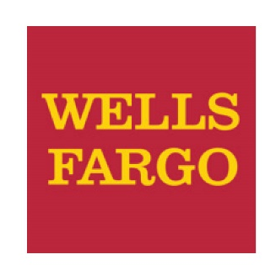



Join the Minnesota Chamber Foundation investors driving our work.
Title of presentation here

Slide 31
Title of presentation here
If your business interested in taking meaningful and intentional action towards a more diverse, equitable, and inclusive workplace or is interested in participating in our DEI assessment pilot, please reach out!
CONTACT INFO
Whitney Harvey
Senior Director Workforce Diversity and Inclusion
612.618.6074
wharvey@mnchamber.com

