Slide 1
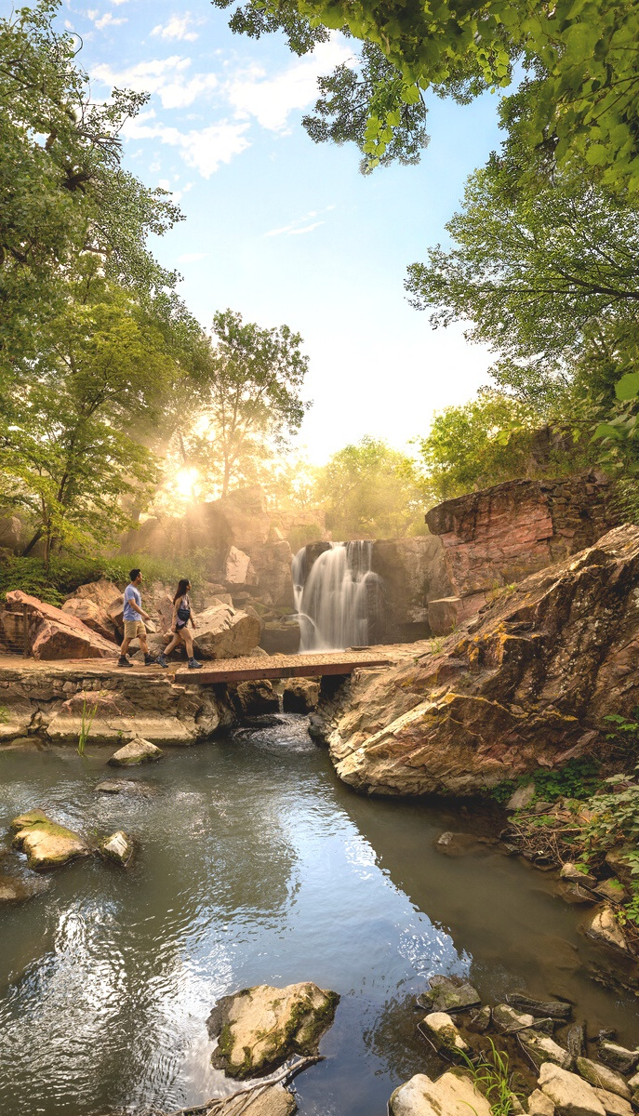
HARNESSING THE POWER OF TOURSIM
EXPLORE MINNESOTA
Lauren Bennett McGinty, Executive Director
exploreminnesota.com | exploreminnesota.com/industry

Slide 2
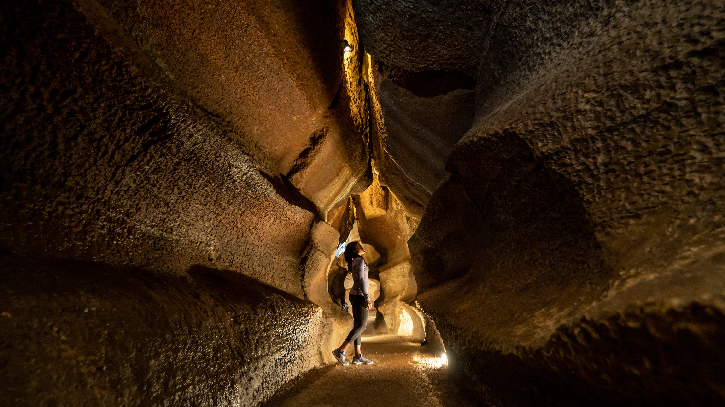
A JOURNEY TO MOVE BEYOND RECOVERY AND INTO A BIGGER FUTURE.

Slide 3
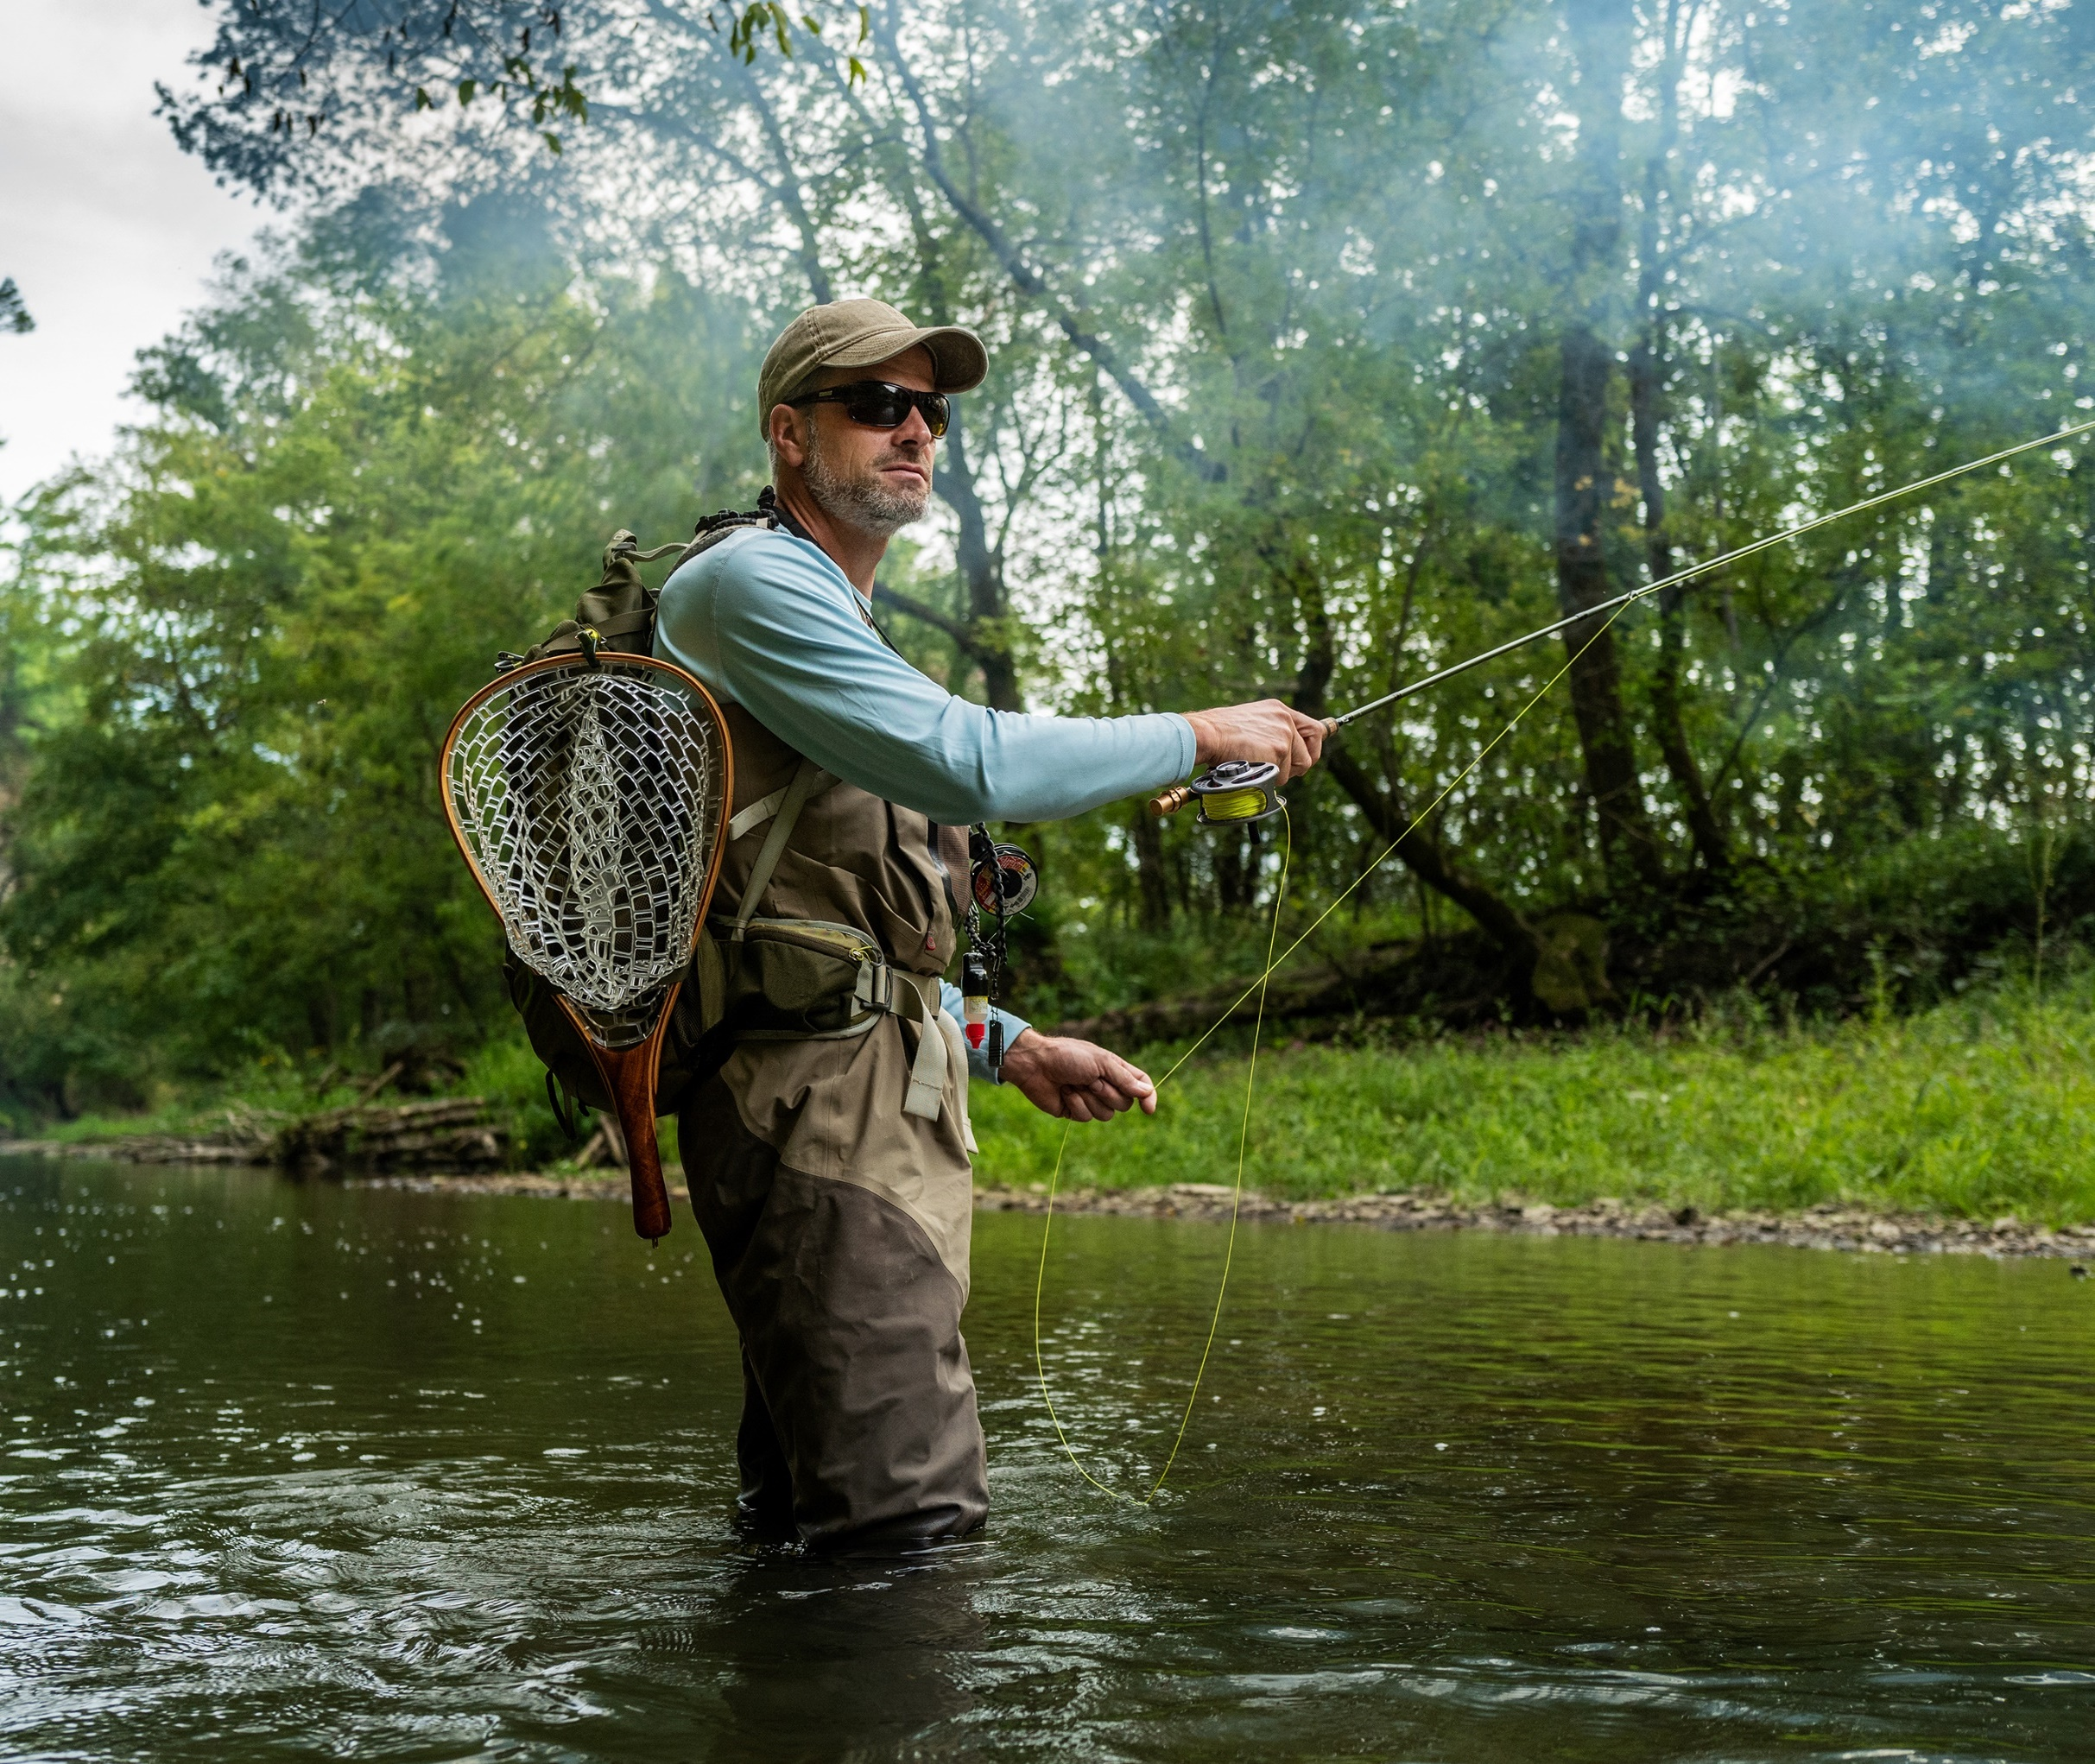
ONLY DOWN 3.2% AT THE END OF 2022
$13.4 billion direct impact
$23.3 billion indirect impact
$993 / household / year savings
Outdoor rec was 2.4% of MN GDP

Slide 4
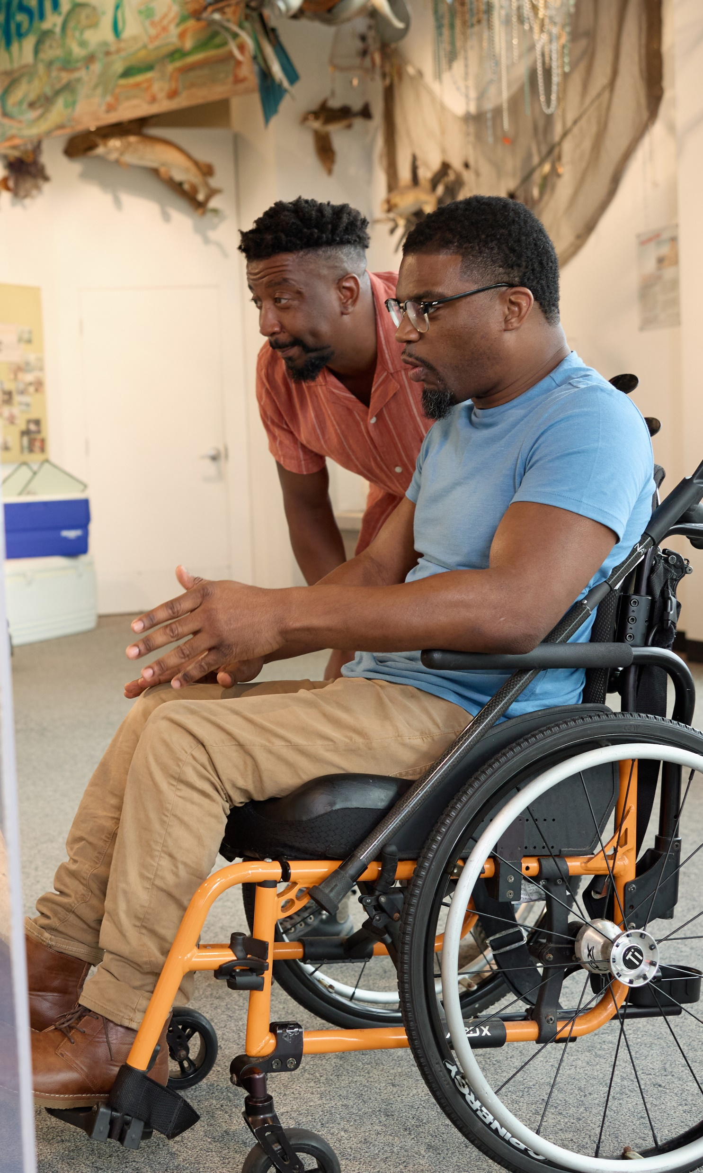

Slide 5
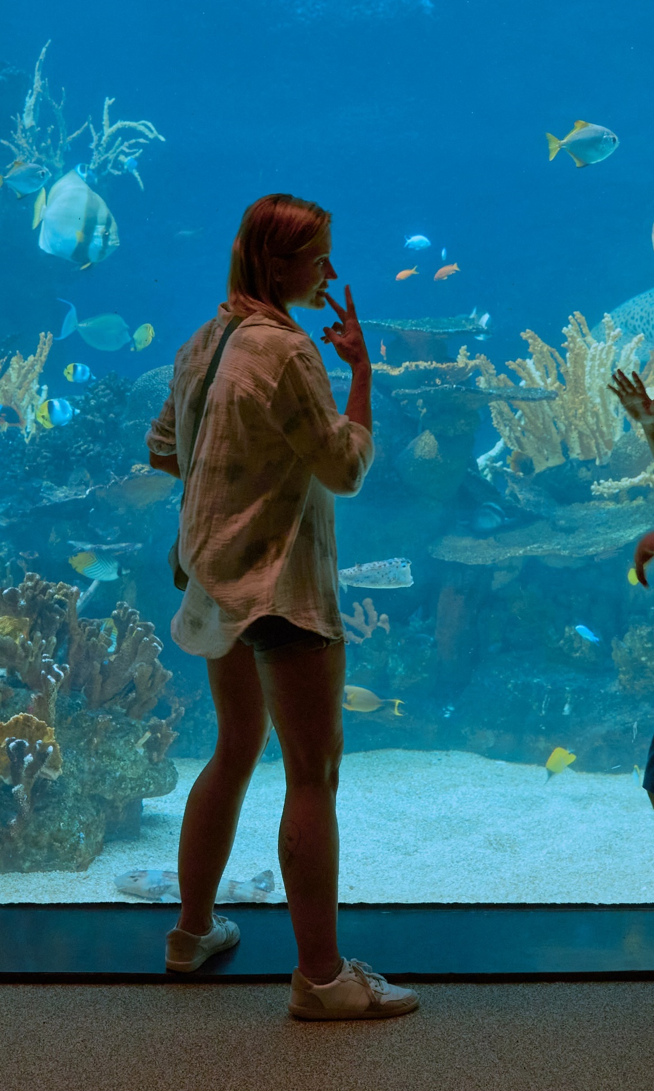

Slide 6
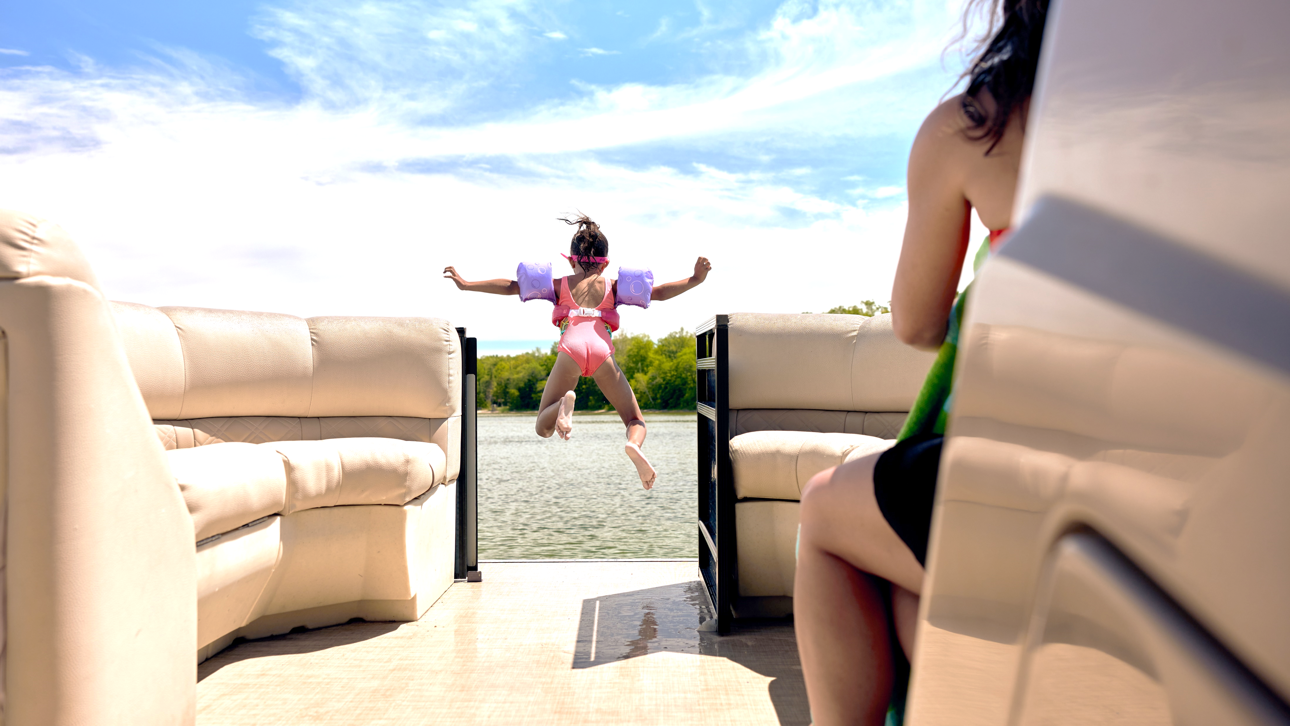
GOVERNOR
RECOMMENDS LARGEST-
EVER
BUDGET INCREASE

Slide 7
COME ONE, COME ALL
$3.88m base budget increase in FY24
$746,000 in subsequent years to maintain level of service in FY25
$11m FY24 -FY25 (onetime)
$11m in FY24 for Explore Minnesota for Business (onetime)

Slide 8
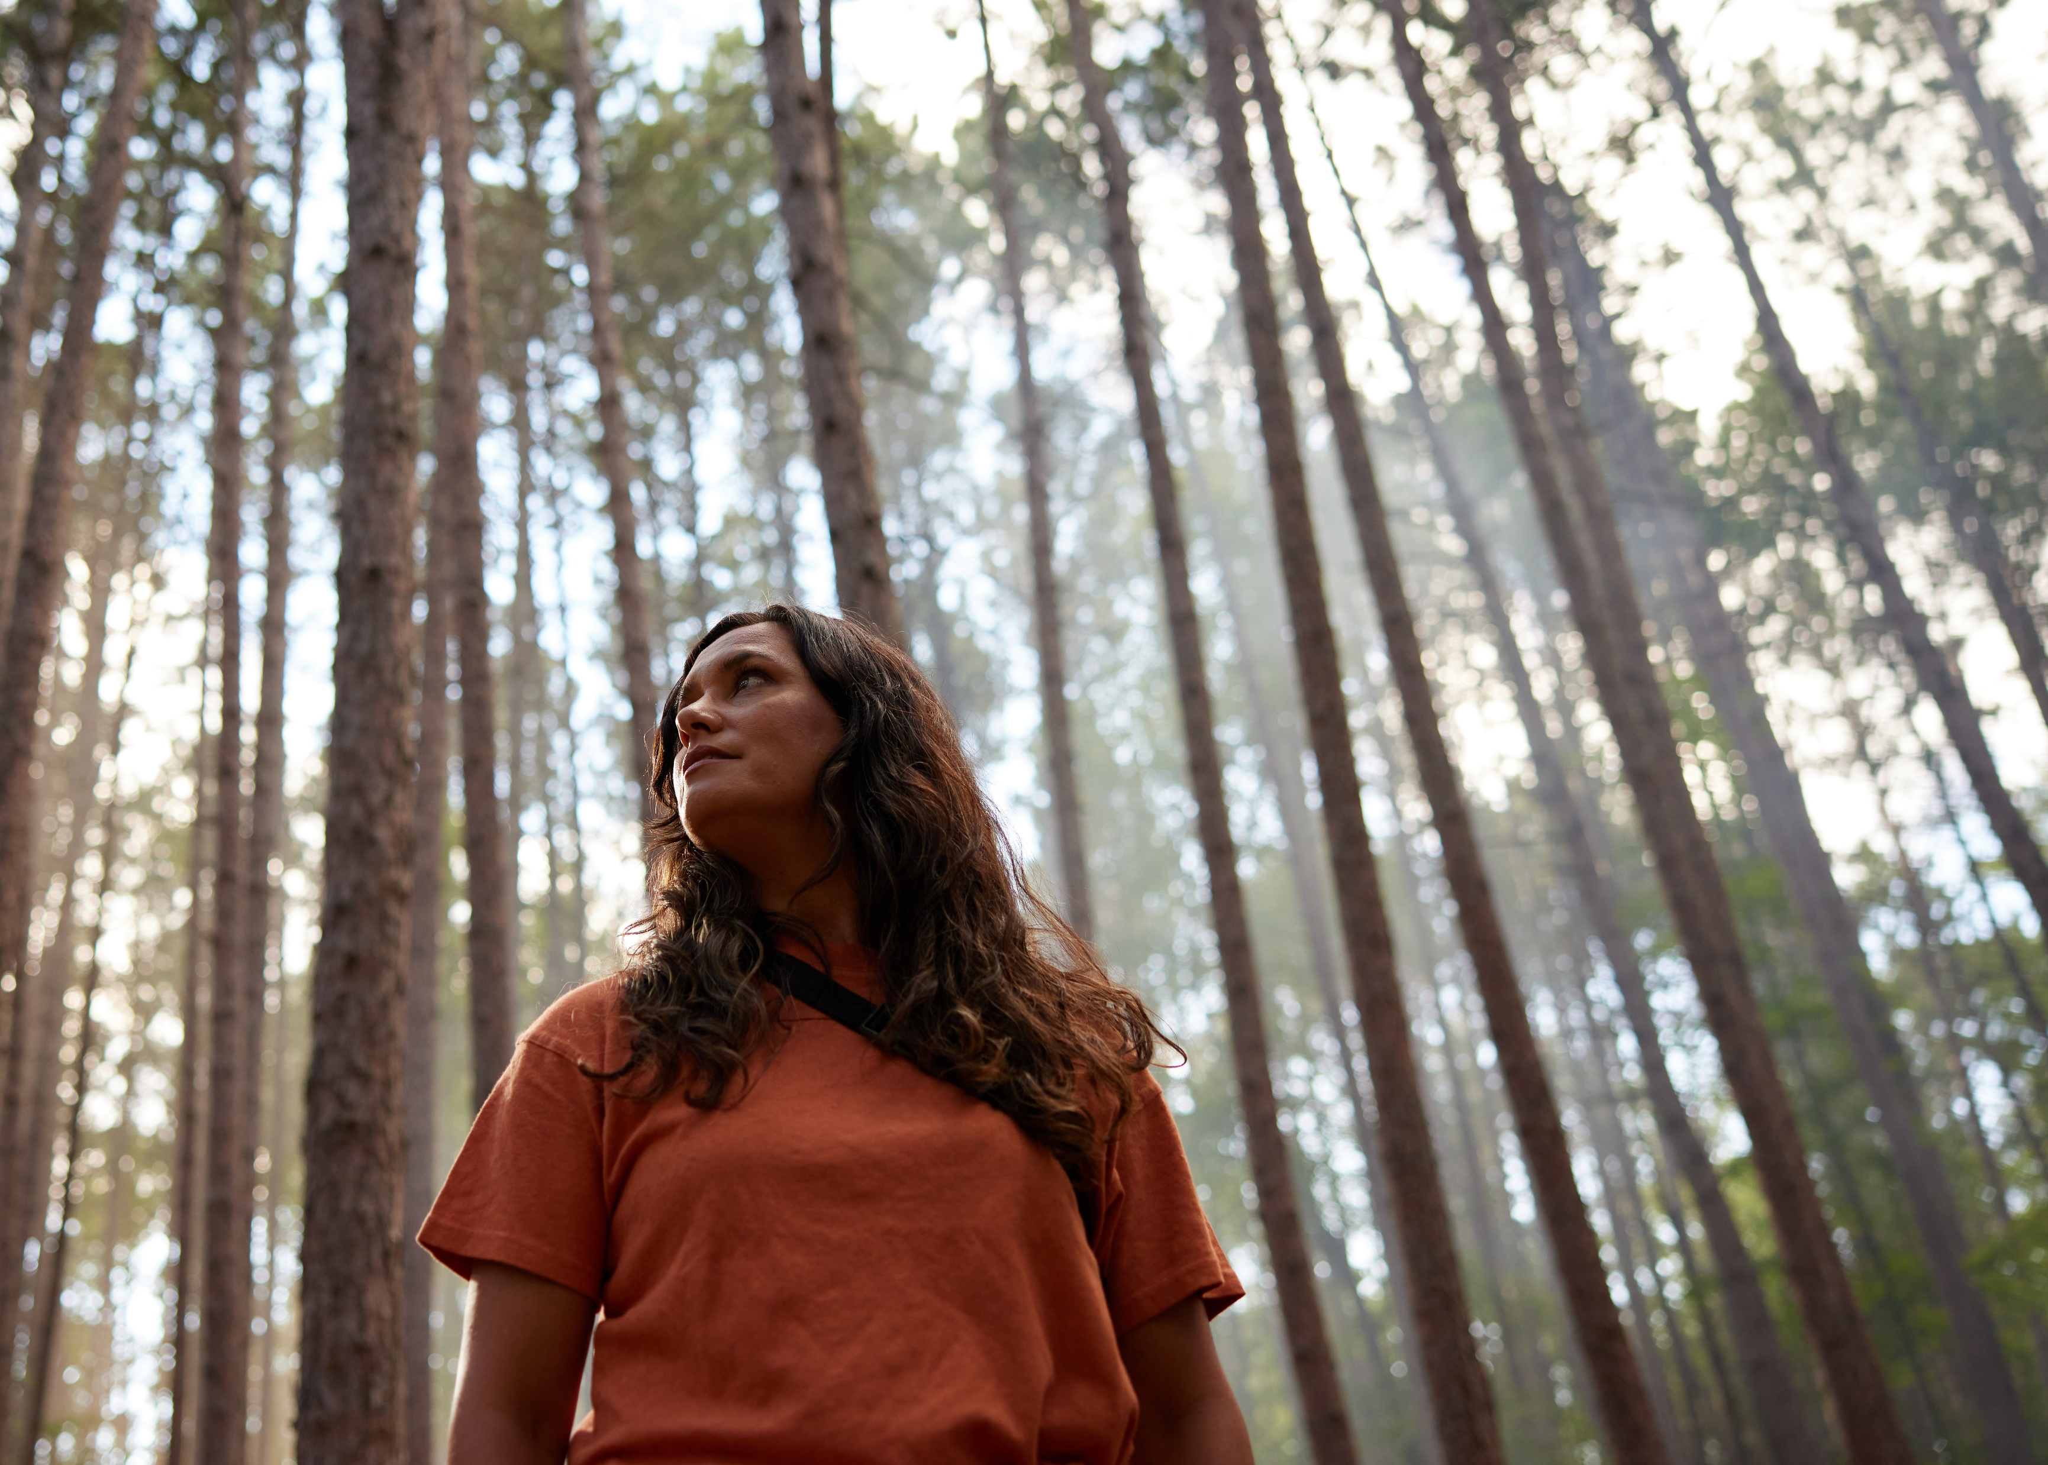
ONETIME FUNDING OVERVIEW
$11 million in FY24-25
$6m for Minnesota Sports & Events
$2.2m in grants to Tribal Nations
$2m in recovery & marketing grants
$11 million in FY24-25
Explore Minnesota for Business
Livability marketing
Talent attraction in key markets and for top industries

Slide 9
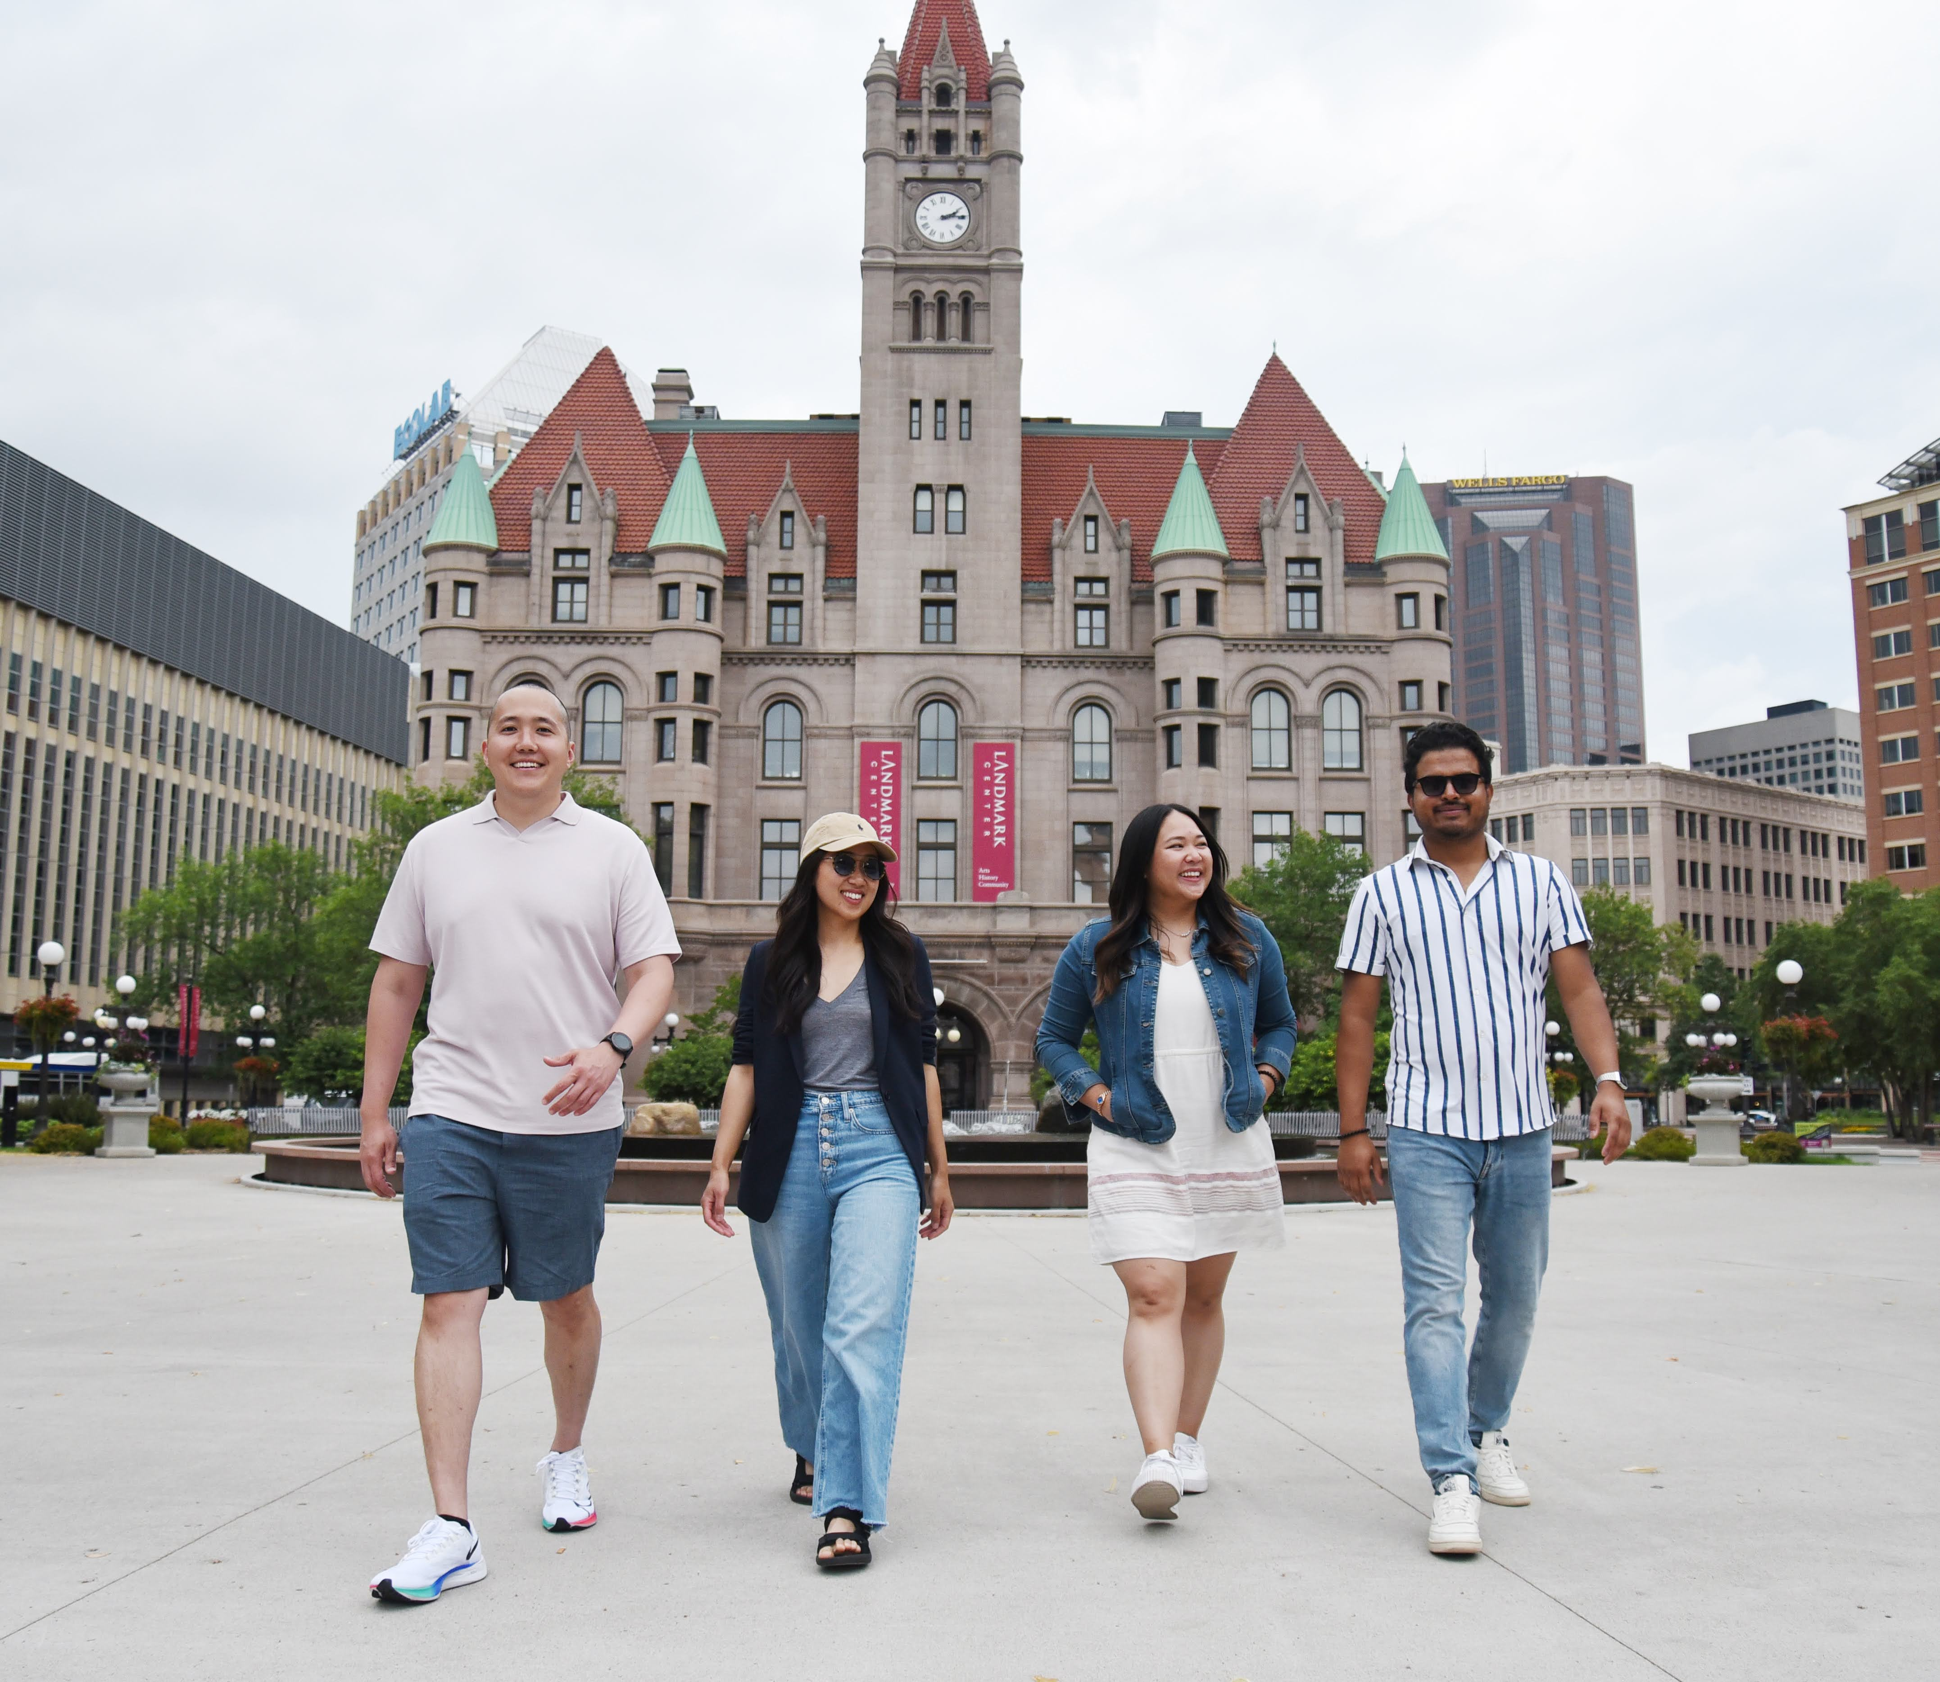
“WHERE TO FIND PEOPLE TO FILL JOBS”
54% more likely to think of MN as a good place to start a business
76% more likely to consider it a good place to live
106% more likely to think it's a good place to start a career

Slide 10
#1 IN FORTUNE 500 COMPANIES PER CAPITA
#2 BEST STATE FOR ECONOMIC OPPORTUNITY
#2 BEST OVERALL STATE IN AMERICA
#3 FOR SMALL-BUSINESS JOB GROWTH
BEST AIRPORT IN NORTH AMERICA
LEAST STRESSED STATE
#2 BEST STATE TO RAISE A FAMILY
#1 MEDICAL DEVICE PATENTS PER CAPITA
#1 MOST ACTIVE STATE
#2 FOOD PRODUCTS PATENTS PER CAPITA

Slide 11
A LITTLE HUMBLE
BRAGGING
Consistent state messaging about livability, tourism and economic opportunity
Leverage industry partners and existing resource
Attracting new audiences
Fill job in key industries
Basically, tell everyone what they are missing

Slide 12
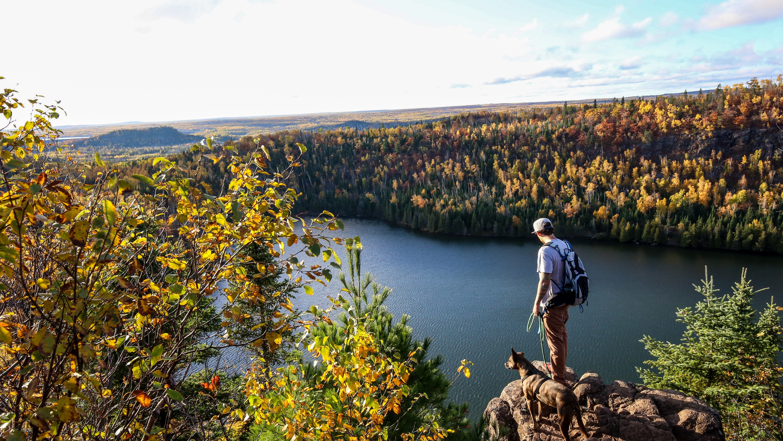
KEY INITIATIVES ON THE HORIZON

Slide 13
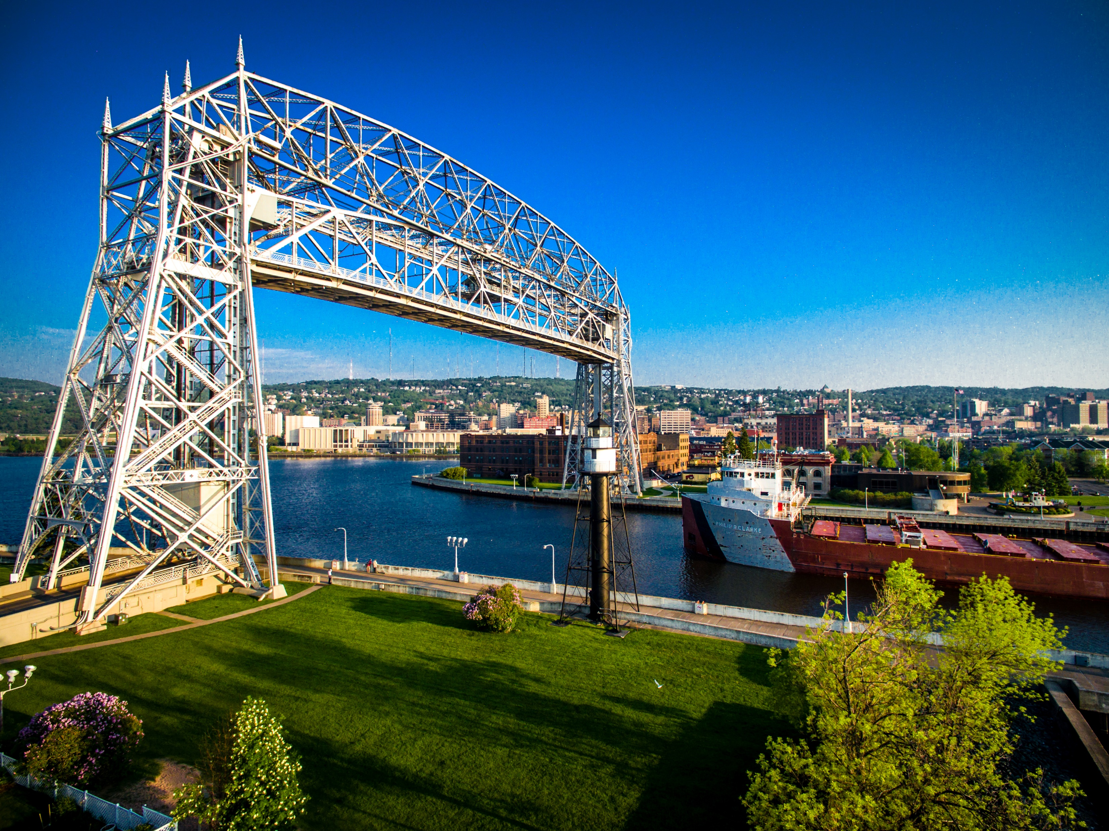
GROW MN’S VISITOR ECONOMY
New marketing campaign starting Spring/Summer 2024
Adding new flight markets for consideration
Increasing spend in diverse media
Adding longer-form videos with local influencers in MN to attract new visitors
New digital strategy manager to harness the power of the website
Marketing of L&H careers > EMB

Slide 14
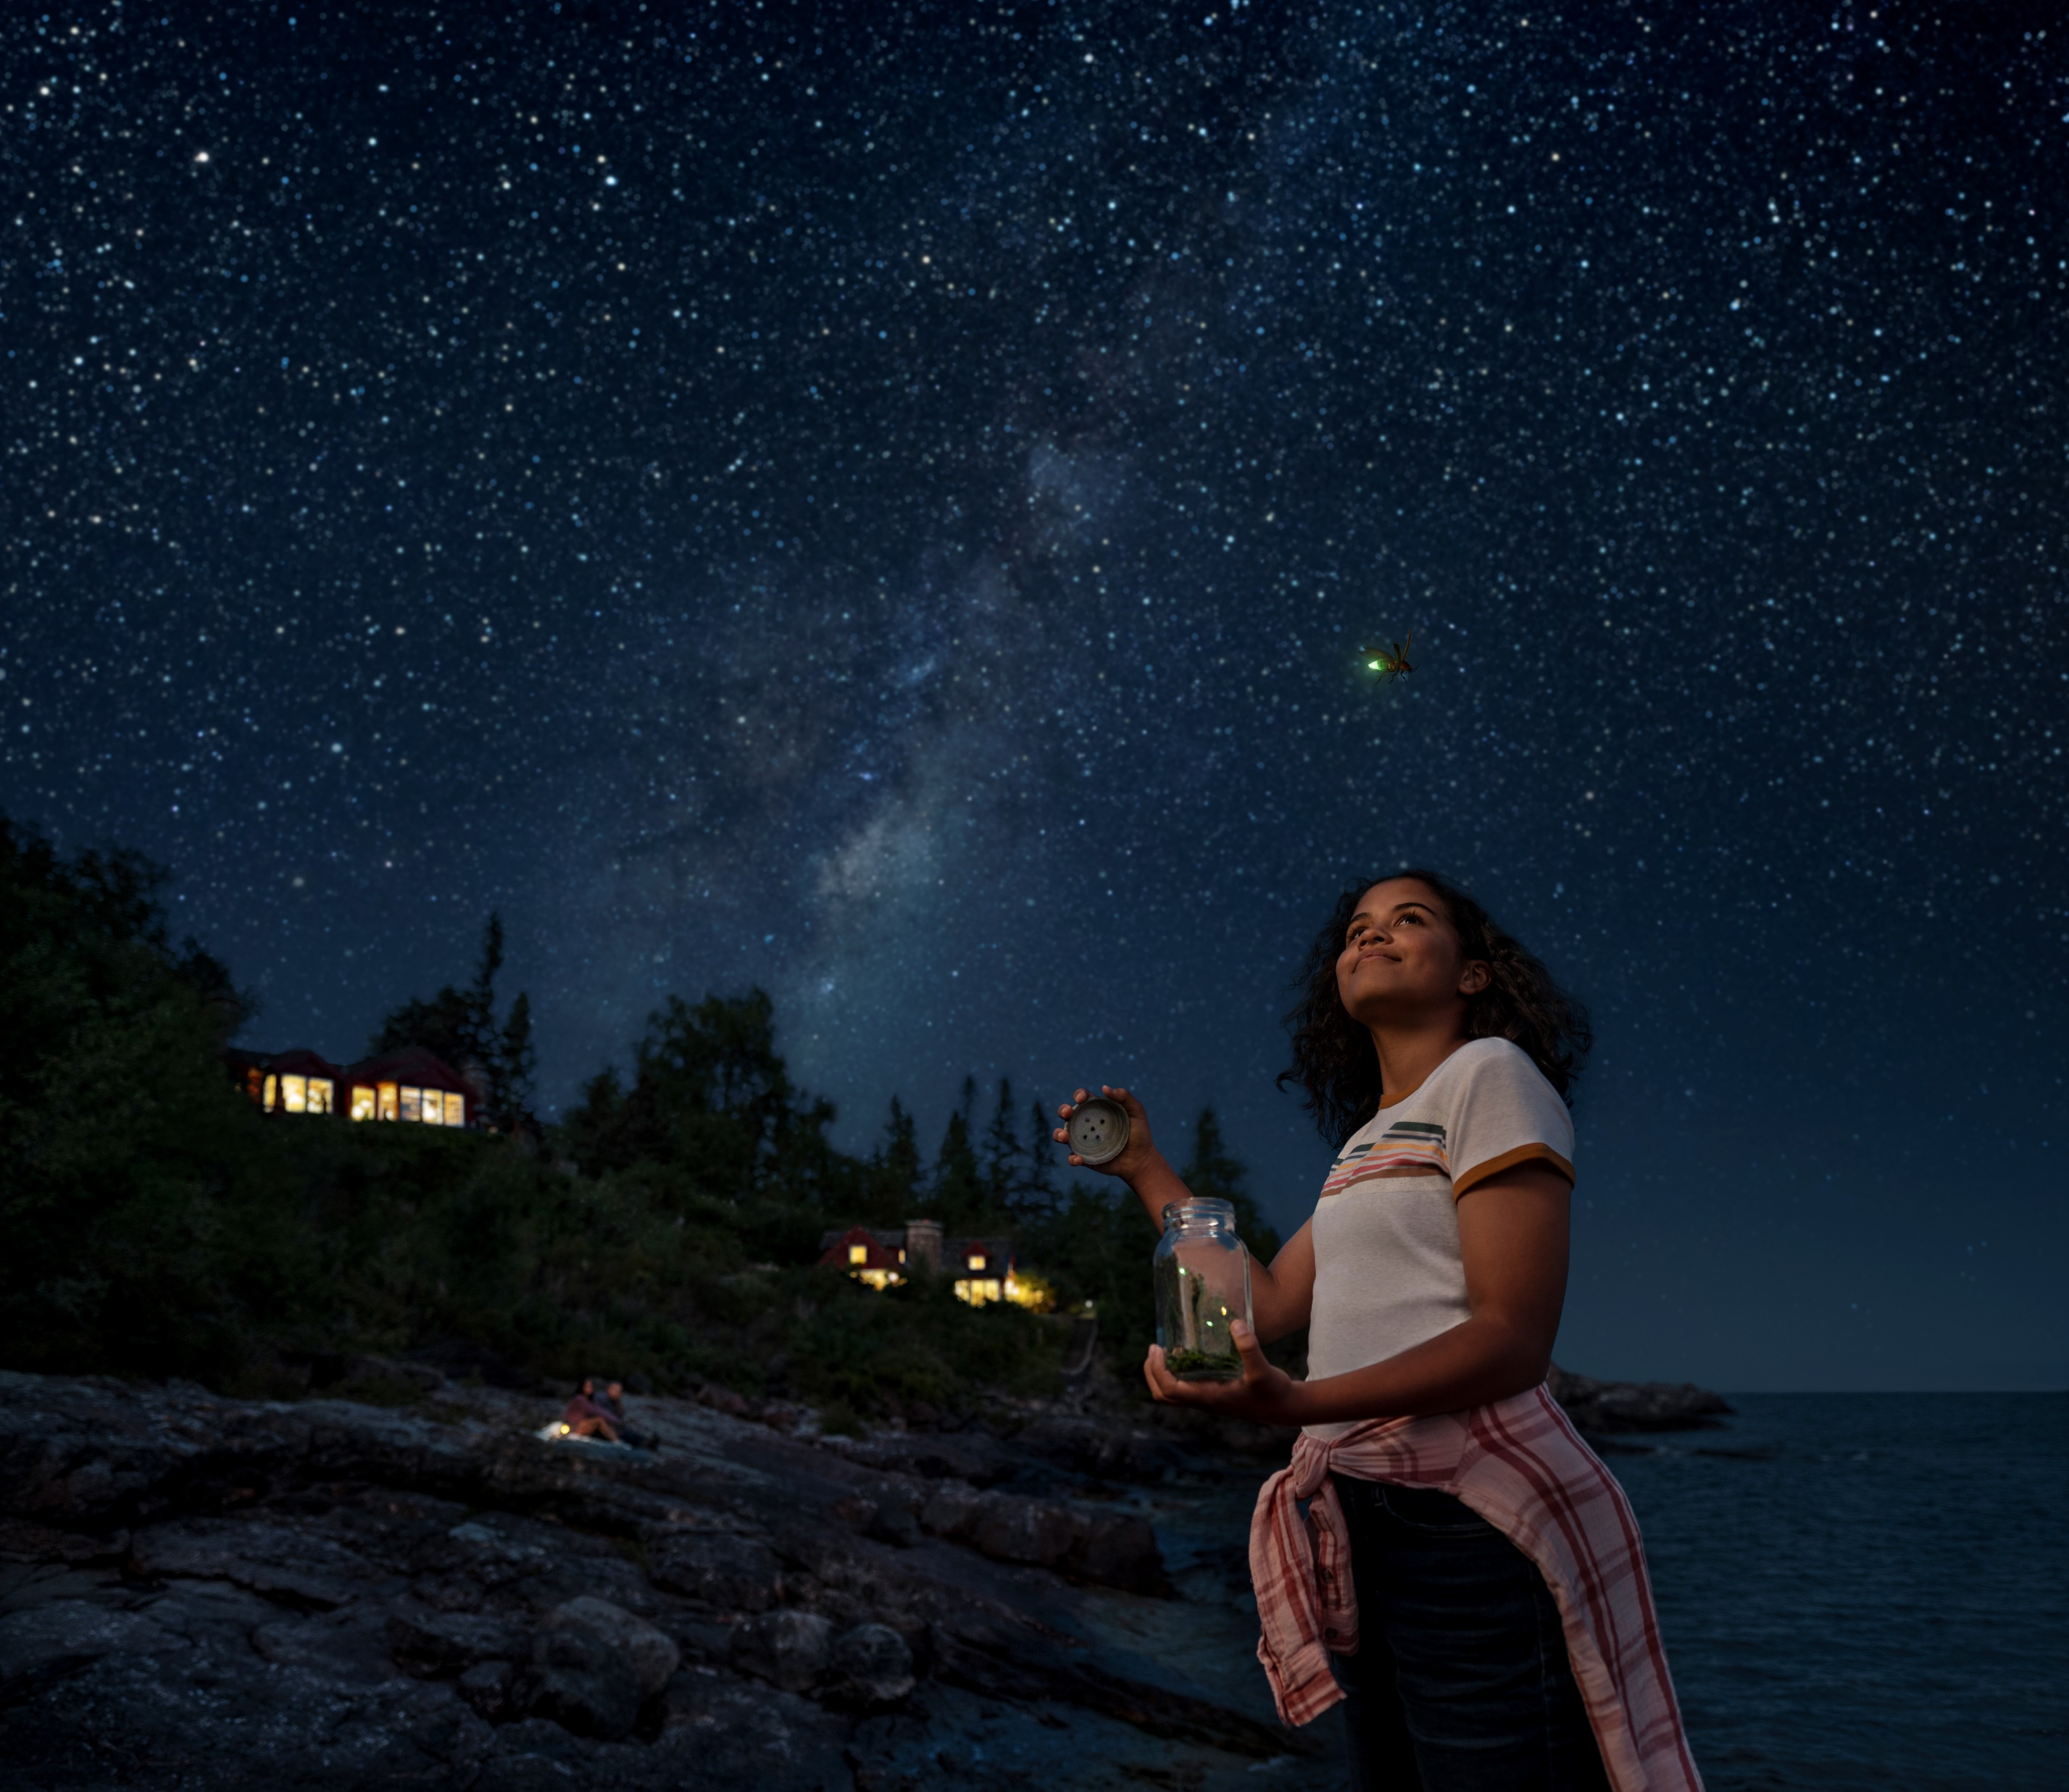
CREATE A WELCOMING EXPERINCE
Increased cultural community engagement
Create a more integrated marketing plan to uplift diverse voices throughout the marketing campaign
Increase engagement and collaboration with other state agencies and designated councils

Slide 15
MAXIMIZING STAKEHOLDER COLLABORATION
Build legislative relationships and increase advocacy with elected officials to share why #TourismMatters
Up the budget for co-ops/partnerships to leverage local marketing and enable EMT to spend more out of state
Increase stakeholder engagement/feedback opportunities

Slide 16
FOSTER DESTINATION STEWARDSHIP
New research and consultancy in 2024
Determine baseline of where we can support destinations through sustainability of travelers
Create an action plan with other state agencies in relation to resource/environmental management
Determine destination development ideas

Slide 17
THANK YOU!
CONTACT:
Lauren Bennett McGinty
Executive Director
Lauren.Bennett.McGinty@state.mn.us
651.757.1844

